Slide 1
MULTIMEDIA COMMUNICATION
Dr. Quang Duc Tran

Slide 2
About ME
Contact Information
Room B1-801 (10 am - 11 am Every Tuesday)
Department of Data Communication and Computer Network
School of Information and Communication Technology
Hanoi University of Science and Technology
E-mail: ductq@soict.hust.edu.vn
Tel: (+84) (4) 38682596
Education
PhD in Information Engineering, 2014
MSc in Electrical Engineering, 2008

Slide 3
Aim of this Module
Describe the theory and operation of the major technologies and equipment of relevance to the media and information industries
Introduce you to the multimedia communications and its range of applications and networking infrastructures
Learn about different media types (text, images, speech, audio and video) and applications (VoIP, Video on Demand, multimedia electronic mail, interactive television and others)

Slide 4
Syllabus
Topic 1: Introduction to Multimedia Communication
Topic 2: Digitalization Principles
Topic 3: Text Processing
Topic 4: Digital Image Processing
Topic 5: Audio Processing
Topic 6: Video Processing
Topic 7: Multimedia Network
Topic 8: Quality of Service & Synchronization
Topic 9: RTP, RTCP & RTSP
Topic 10: SIP & H323

Slide 5
References
Jens-Rainer Ohm, “Multimedia Communication Technology”, Springer-Verlag Berlin 2014.
William Stallings, “Data and Computer Communication”, Prentice Hall – New Jersey 2007
J.D. Gibson, Editor, “Multimedia Communication”, Academic Press, San Diego, CA, USA, 2001.
L.L Ball, “Multimedia Network Integration and Management”, McGraw-Hill, 1996.

Slide 6
References
S.J. Gibbs, and D. C. Tsichritzis, “Multimedia Programming”, Addison-Wesley, New York, 1995.
W. Kou, “Digital Image Compression”, Kluwer publishers, London 1995.
S.J. Solari, “Digital Video and Audio Compression”, McGraw-Hill, 1997.

Slide 7
Evaluation Method
Final written exam (70%)
Held after the end of the lecturing period
Project (30%)
Written in group of 2-4 students
Shall not have more than 10 pages (printed)
Deadlines: 18/05/2015
Includes application and discussion

Slide 8
Project Topics
Application: Video On Demand service (3)
Application: Asterisk based Call Center (4)
Application: Simple Video Chat Program (2)
Application: Video Conferencing System (4)
Application: Media Center using KODI (4)
FFMPEG: Video Codec Comparison (2)
FFMPEG: Video Streaming Server (2)

Slide 9
INTRODUCTION
Dr. Quang Duc Tran

Slide 10
Multimedia Concepts
Multimedia:
Multimedia = Integration of multimedia data (text, speech, audio, video and images)
Multimedia Communication is originated in a confluence of two technological trends, i.e., Multimedia computing and Networking.
Applications: Video/Audio conferencing, education, entertainment, and monitoring of remote locations, etc.

Slide 11
Data vs. Signal
To be transmitted, data must be transformed to electromagnetic signals. Signal is continuously varying electromagnetic wave that may be propagated over a variety of medium, depending on spectrum.
Data can be analog or digital. Analog data takes on continuous values on some interval (e.g., voice and video). Digital data takes on discrete values (e.g., text, integer).
Signals can be analog or digital. Analog signal have an infinite number of values in a range; Digital signals can have only a limited number of values.

Slide 12
Data vs. Signal (Cont.)
To achieve longer distances, the analog transmission system includes amplifiers that boost the energy in the signal. The amplifier also boosts the noise components. The signal becomes more and more distorted.
For analog data, such as voice, a bit of distortion can be tolerated. For digital data, the amplifier introduce errors.
For analog signal, the transmission system has repeaters. The repeater recovers the digital data from analog signal and generate a clean analog signal.

Slide 13
Periodic vs. non-periodic signal
A periodic signal completes a pattern within a measurable time frame, called period, and repeats such a pattern over subsequent identical periods. One full pattern is known as a cycle.
A non-periodic signal changes without exhibiting a pattern or cycle that repeats over time.
In data communications, we commonly use periodic analog signals and non-periodic digital signals.

Slide 14
Multimedia Data
Text: Block of characters, each represented by a fixed number of binary digits (bit), known as codeword.
Still images (e.g., graphics, pictures): Two dimensional blocks of picture elements represented by a fixed number of bits
Sound and Video: Type of signal is known as an analogue signal and varies continuously with time (e.g., telephone conversation can last for several minutes while a movie (audio + video) can last for a number of hours).
Animation: Sequence of graphics.

Slide 15
Media Type Classification
Captured vs. synthesized media
Captured media (natural): information captured from the real world (examples?).
Synthesized media (artificial): information synthesized by the computer (examples?).
Discrete vs. continuous media
Discrete media: spaced-based, media involves the space dimension only (examples?).
Continuous media: time-based, media involves both the space and the time dimension (examples?)

Slide 16
Media Type Classification
Sound
Video
Animation
Continuous
Continuous
Image
Text
Graphics
Discrete
Discrete
Captured from real world
Synthesized by computer

Slide 17
Text
Plain text
Unformatted
Characters coded in binary form
ASCII code
All characters have the same style and font
Rich text (RTF)
Formatted
Contains format information besides codes for characters
No predominant standards
Characters of various size, shape and style, e.g., bold, colorful

Slide 18
Text Coding & Compression
Text coding
ASCII
Standard code table (7 bit – 128 characters)
Extended code table (8 bit – 256 characters)
Unicode
16 bit system (65,536 characters)
> 110,187 graphical, formatting and control characters
Text compression
Statistical compression: Huffman code
Compression using dictionary: Lempel-Ziv
Compression rate: 1/2 - 2/3 document size

Slide 19
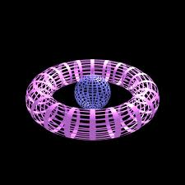
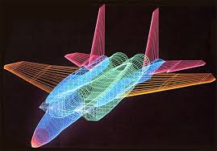
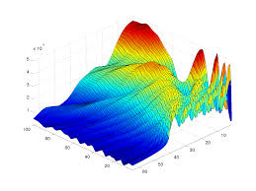
Graphics
Revisable document that retains structural information
Consists of objects such as lines, curves, circles, etc.
Usually generated by graphic editor of computer programs, such as Corel Draw, Adobe Illustrator

Slide 20
Still Image
2D matrix consisting of pixels
Pixel: smallest element of resolution of the image
One pixel is represented by a number of bits
Pixel depth: the number of bits available to encode the pixel
Have no structural information
Possibly scanned and synthesized still image
Computer Software
Synthesized image
Camera
Capture and A/D conversion
Scanned image

Slide 21
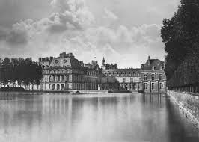
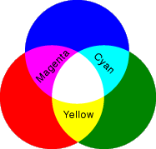

Still Image (Cont.)
Examples of images
Binary image: pixel depth 1
Grayscale image: pixel depth 8
Color image: pixel depth 24
Pixel (RGB)

Slide 22
Graphics vs. Still Image
Graphics
Revisable documents
Document format retains structural information
Semantic content is preserved in presentation
Described by objects
Images
No revisable
Document format is unaware of any structural information
Semantic content is NOT preserved
Described as bitmaps formed of individual pixels

Slide 23
Image Compression
Lossless compression
Run-Length coding (RLC)
Lempel-Ziv coding
GIF, BMP, TIFF
Lossy compression
Transform coding
Chroma sub-sampling
JPEG, JPEG2000

Slide 24
Video
Video - moving images or moving pictures
Captured or Synthesized
Consists of a series of bitmap images
Frame rate: the speech to playback the video
NTSC (US, Japan): 30 frames/s
PAL (EU): 25 frames/s
SECAM (France): 24 frames/s
HDTV: 50/60 frames/s
UHDTV: 120 frames/s

Slide 25
Video vs. Animation
Both images and graphics are displayed as a succession of view, which creates an impression of movement.
Video - moving images or moving pictures
Captured or Synthesized
Consists of a series of bitmap images
Animation - moving graphics
Generated by computer program
Consists of a set of objects
The movement of the objects are calculated

Slide 26
Video Compression
International Telecommunication Union (ITU-T)
H.261: ISDN Video Phone (px64 kb/s)
H. 263: PSTN Video Phone (<64 kb/s)
H.26L: A variety of applications (<64 kb/s)
Internet Video Application, VOD, Video Mail
International Organization for Standard (ISO)
MPEG-1 Video: CD-ROM (1.2 Mb/s)
MPEG-2 Video: SDTV, HDTV (4-80 Mb/s)
MPEG-4 Video: A variety of applications (24-1024 kb/s)

Slide 27
Sound
Sound (e.g., speech, music, noise)
Analog 1-D time-based signal
Vibration that propagates as a typically audible mechanical wave of pressure and displacement through a medium such as air or water.
Sound wave: Sinusoidal planes wave, which has the following properties
Frequency
Wavelength
Amplitude
Human ear: 20-20,000 Hz. The upper limit decreases with age

Slide 28
Digital Audio
Audio signal that is encoded in digital form
Sampling
Quantization
Sampling rate
Telephone: 8 kHz
CD-audio: 44.1 kHz
Quantization
Speech: 8 bit
CD-audio: 16 bit
Audio Compression
Lossless compression: FLAC, Apple Lossless, MPEG-4 ALS
Lossy compression: MP3 (50-60% of original size)

Slide 29
A Simple Data Communication Model
Source generates the data to be transmitted (Examples?)
Transmitter transforms and encodes the information to produce electromagnetic signals that can be transmitted across some sort of transmission system.
Transmission system can be transmission line or a complex network connecting source and destination
Receiver accepts the signals and convert them into a form that can be handled by the destination device.
Destination takes the incoming data from the receiver.
Source
Transmitter
Transmission System
Receiver
Destination

Slide 30
Communication Tasks
Transmission system utilization Interfacing Signal generation Synchronization Exchange management Error detection and correction | Flow control Addressing Routing Recovery Security Network management
Notes:
Transmission system utilization refers to the need to make efficient use of transmission facilities. Congestion control techniques may be required to assure the system is not defeated by excessive demand of transmission services.
Interface: a device must be able to communicate with the transmission system.
Synchronization: the receiver must be able to determine when the signal begins to arrive and when it ends. It must also know the duration of each signal element.
There are a variety of communication requirements might be collected and exchanged under exchange management.
Flow control ensure the receiver is not defeated by a faster sender.
Recover is needed in situations where an information exchange such as file transfer is interrupted due a fault somewhere in the system. The activity should be resumed at the point of interruption.
Security: Only intended party actually receive the data.
Network management is needed to configure the system, monitor its status, react to failures and overload.

Slide 31
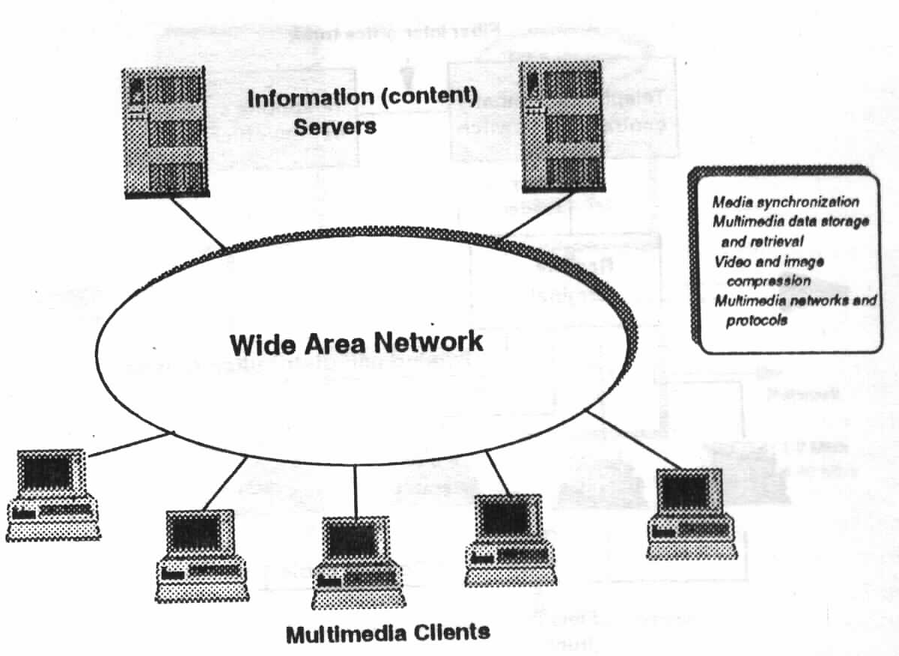
Distributed Multimedia System
Distributed Multimedia System involves transmission and distribution of multimedia information on the network.
Multimedia Servers
Silicon Graphic
HP Media Server
Multimedia Networks
PSTN/Data Network etc.
Multimedia Clients

Slide 32
Distributed Multimedia System (Cont.)
Live media transmission system
Capture, compress, and transmit the media on the fly (example?)
Send stored media across the network
Media is pre-compressed and stored at the server. This system delivers the stored media to one or multiple receivers (example?)
Differences between the two systems
Media capture: Real-time media capture vs. pre-stored media.
Media compression: Real-time/off-line compression?, compression can be adjusted during transmission?

Slide 33
Distributed Multimedia System (Cont.)
Requirements of networked multimedia applications
Delay requirements
Quality requirements
Satisfactory quality of media presentation
Synchronization requirement
Continuous requirement
Can tolerate some degree of information loss
Challenges of distributed multimedia system
Conflict between media size and bandwidth limit
Conflict between the user requirement of multimedia application and the best-effort network.
How to meet different requirement of different users?

Slide 34
Multimedia Server
Tape storage
Multimedia Servers
Data storage and retrieval
Media synchronization
Video/Audio Compression
Requirements
High performance
High reliability
CPU
Tape
Controller
System bus
Network
Disk
Controller
Network
adapter
High-speed
bus
Disk on-line
storage
MPEG-1: 1-2 Mb/s
MPEG-2: 2-40 Mb/s

Slide 35
Multimedia Equipments
Digital equipments:
Computers
A/D, D/A converters for Video and Audio.
Analogue equipments:
Video camera,
Microphone, Speaker,
Tape player/recorder.
Synchronization equipments:
Support time synchronization.
Interactive equipments:
Display, mouse, keyboard etc.

Slide 36
Multimedia Networks
Telephone Networks:
Public switched telephone networks (PSTNs): initially designed to provide speech services, now can support multimedia applications due to the advances in Digital Signal Processing hardware and software.
Data Networks: initially supported data applications (e-mail/ftp), now support much complex multimedia applications.
Broadcast Television Networks: Broadcast TV
Broadband Multiservice Networks: Multiservice.

Slide 37
Multimedia Operating System
Multimedia operating system provides a comfortable environment for the execution of programs, and ensures effective utilization of the computer hardware.
Multimedia Applications
Multimedia I/O
Manager
Stream
Handlers
Multimedia Device
Manager
Physical Device
Driver
Stream and
Synchronization manager
Multimedia I/O Drive
Audio/ video codec
Hard disc
drive
Optical
drive
CD ROM
drive
Analog video
NTSC, PAL
Analog
audio
PCM
Monitor

Slide 38
Multimedia Operating System (Cont.)
MMOS Requirements:
Soft real-time applications: statistical guarantees
Interactive applications: no absolute performance guarantees, but low average response times
Throughput-intensive application: no performance guarantees, but high throughput.
Fair, Proportionate resource allocation: Divide resources according to application requirements.
Application Isolation: Preventing misbehaving or overloaded application from effecting others (e.g., overloaded web server should not affect streaming media server).
Notes:
Hard real-time applications are designed for specialized purposes, where even smallest amount of latency can make the difference between life and death. These applications include triggering airbag deployment in car crashes or monitoring the heart rate of a patient during an operation.
Soft real-time applications: no absolute performance guarantees can be made.

Slide 39
Multimedia Operating System (Cont.)
Root
Root
I
TP
SRT
I
SRT
TP
Http
SRT
Class-specific Schedulers
33%
33%
33%
33%
66%
Audio
Video
D1
D2
Audio
Video
C
Class-Independent
Scheduler
20%
80%
50%
50%
20%
80%
FCFS
CPU Scheduler
Packet Scheduler
Disk Scheduler

Slide 40
Multimedia Applications
Multimedia Information Systems: Multimedia Database, Information hypertexts, Hypermedia, Electronic books, Multimedia expert systems, etc.
Multimedia Communication Systems: VOIP, Audio-video Communication, Computer-supported collaborative works, Videoconferencing, IPTV, Streaming media and Multimedia Teleservices, etc.
Multimedia Entertainment Systems: Game, 3D computer games, Multimedia design, Multiplayer networks, Interactive audiovisual productions, etc.

Slide 41
Multimedia Applications (Cont.)
Multimedia Educational Systems: E-Books, E-learning, Flexible teaching materials, Simulation education systems, etc.
Multimedia Business Systems: Electronic commerce, Marketing, Multimedia presentation –PR, Virtual shopping, etc.

Slide 42
Multimedia Application Environment

Slide 43
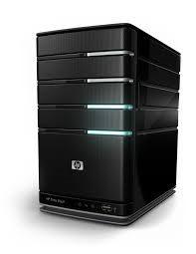
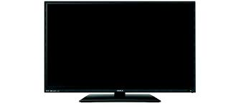
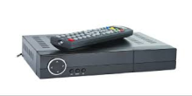
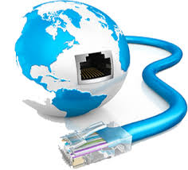
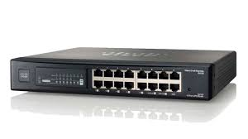
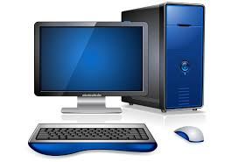
Example (Video on Demand)
ADSL
STB
Media Server
Authentication
/Billing Server
CATV
STB
Router
Streaming Server
Modem
STB
Web Server

Slide 44
DIGITIZATION PRINCIPLES
Dr. Quang Duc Tran

Slide 45
Analog Signals
As mentioned earlier the amplitude of the signal varies continuously with time
The Fourier transform decomposes a signal into the frequencies that make it up
The Fourier analysis can be used to show that any time varying signal is made up of infinite number of single-frequency sinusoidal components

Slide 46
Analog Signals (Cont.)
A band-limited signal x(t) is one whose Fourier Transform is non-zero on only a finite interval of the frequency axis.
There exists a positive number B such that X(f) is non-zero only in -B≤f≤B. B is called the signal bandwidth.
Speech bandwidth: 50Hz – 10kHz
Music Bandwidth: 15Hz – 20kHz
To transmit an analogue signal through a network the bandwidth of the transmission channel should be equal to or greater than the signal bandwidth.

Slide 47
Encoder Design
The encoder consists of AAF (Anti-Aliasing Filter) and an Analogue-to-Digital Converter (ADC)
Analog
Signal
AAF
Sample and Hold
Quantizer
Digital
Codeword
ADC

Slide 48
Encoder Design (Cont.)
Anti-Aliasing Filter (AAF) removes the selected higher frequency components from the source signal.
Sample and Hold samples amplitude of the filtered signal at regular intervals and holds the sampled amplitudes between samples.
Quantizer converts the samples into their corresponding binary form

Slide 49
Data Representation
The most significant bit of the codeword represents the sign of the sample.
A binary 0 indicates a positive value and a binary 1 indicates a negative value.
The signal must be sampled at a much higher rate than the maximum rate of change of the signal amplitude.
The number of quantization levels should be as large as possible to represent the signal accurately

Slide 50
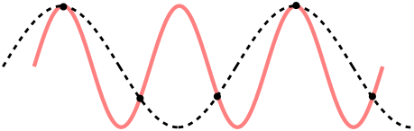
Sampling Rate
Nyquist theorem: If x(t) is a band-limited signal containing no frequencies higher than B. A sufficient sampling rate (i.e., f_{s}) is 2B or anything larger. 2B is called the Nyquist rate.
Nyquist rate is represented either in Hz or more correctly in samples per seconds

Slide 51
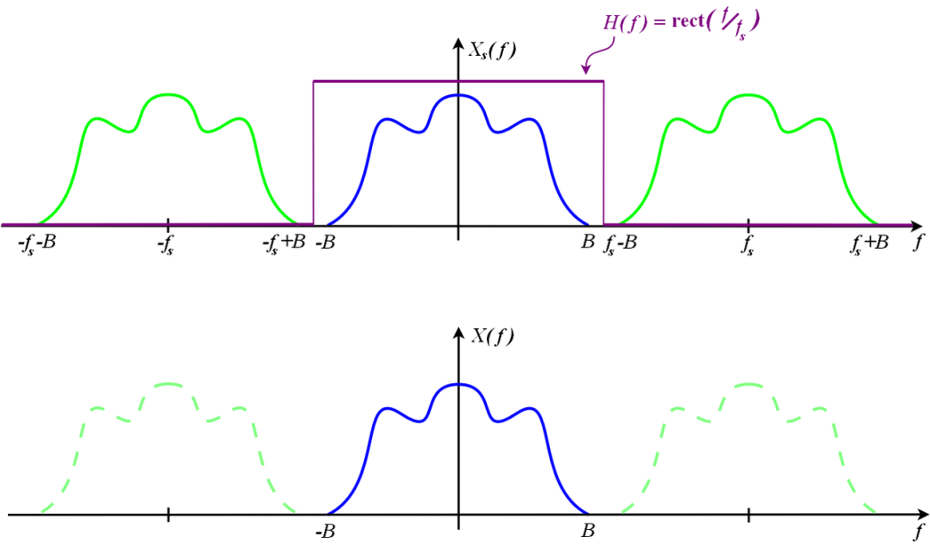
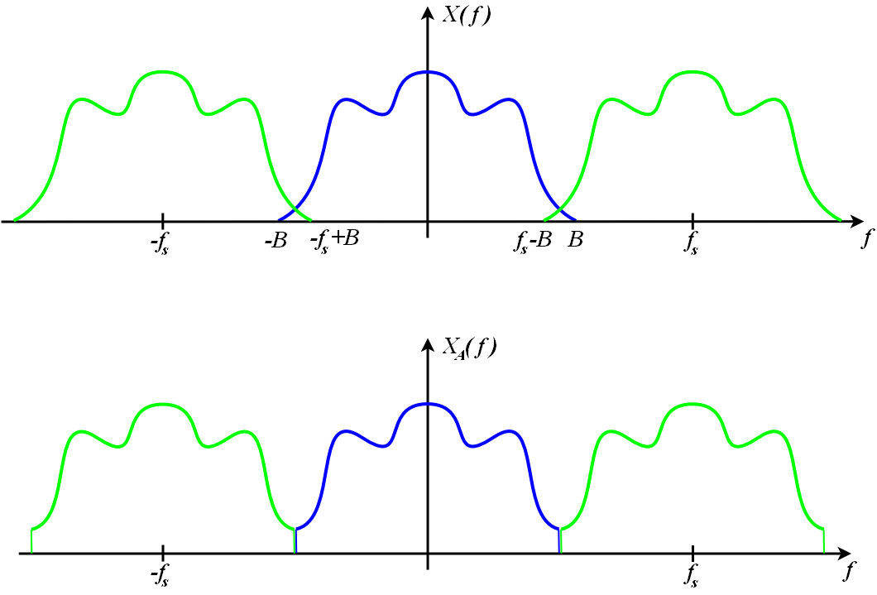
Sampling Rate (Cont.)
For a band-limited signal (X(f) = 0 for all |f|≥B), and f_{s}≥2B, it is possible for the copies to remain distinct from each other. But when the Nyquist criterion is not satisfied, adjacent copies overlap. Any frequency component above f_{s}/2 is indistinguishable from a lower-frequency component, called an alias.

Slide 52
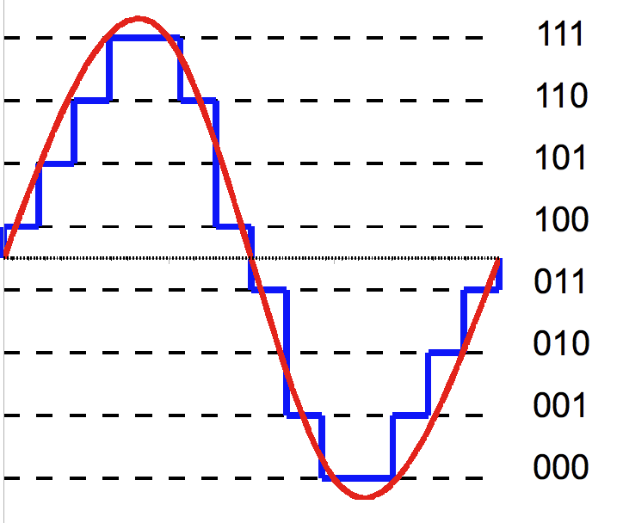
Quantization
Quantization is the process of mapping an analogue value to a number of digits
Three bits are used to represent each sample (1 bit for the sign and two bits to represent the magnitude)
If V_{max} is the maximum positive and negative signal amplitude and n is the number of binary bits used then the quantization interval, q, is defined as
q = V_{max}/2^{n}

Slide 53
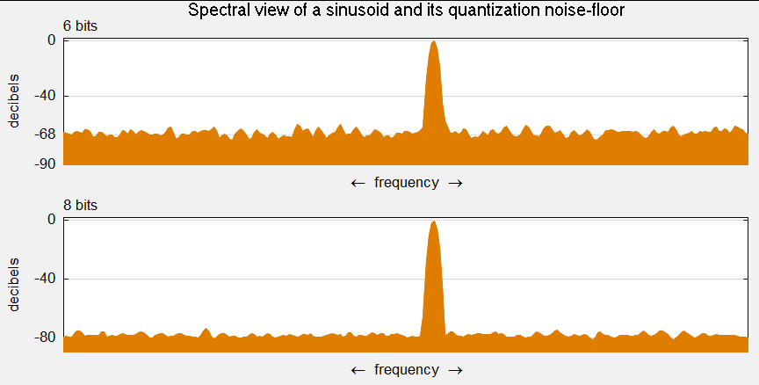
Quantization Error
Quantization error is the difference between the actual signal amplitude and the corresponding nominal amplitude. Consequently, a difference of ±q/2 from the actual signal level is present. Quantization error is also known as quantization noise since values vary randomly
SQNR = 6.02 x n (dB)
SQNR = 1.761+ 6.02 x n (dB)

Slide 54
Decoder Design
A signal decoder is an electronic circuit that performs the conversion prior to their output back again into their analogue form through a digital-to-analogue converter and a low pass filter.
Digital
Codeword
DAC
Low-Pass Filter
Analog
Signal

Slide 55
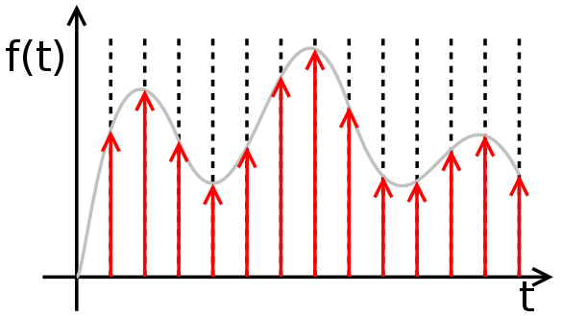
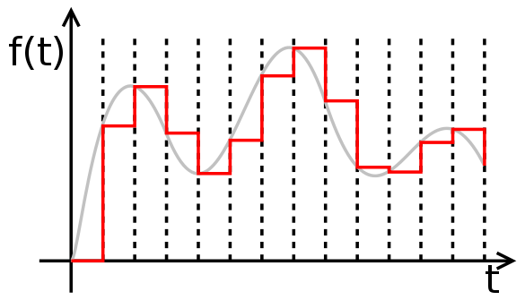
Zero-Order Hold
Zero-Order Hold describes the effect of converting a discrete-time signal to a continuous-time signal by holding each sample value for one sample interval

Slide 56
TEXT
Dr. Quang Duc Tran

Slide 57
Various Types of Text
Unformatted text (i.e., plain text) enables pages to be created, which consist of strings of fixed-sized characters from a limited character set
Formatted Text (i.e., rich text (RTF)) enables pages to be created, which consist of strings of characters of different styles, sizes and shape with tables, graphics, and images inserted at appropriate points
Hypertext enables an integrated set of documents (Each consisting of a formatted text) to be created, which have defined linkages between them

Slide 58
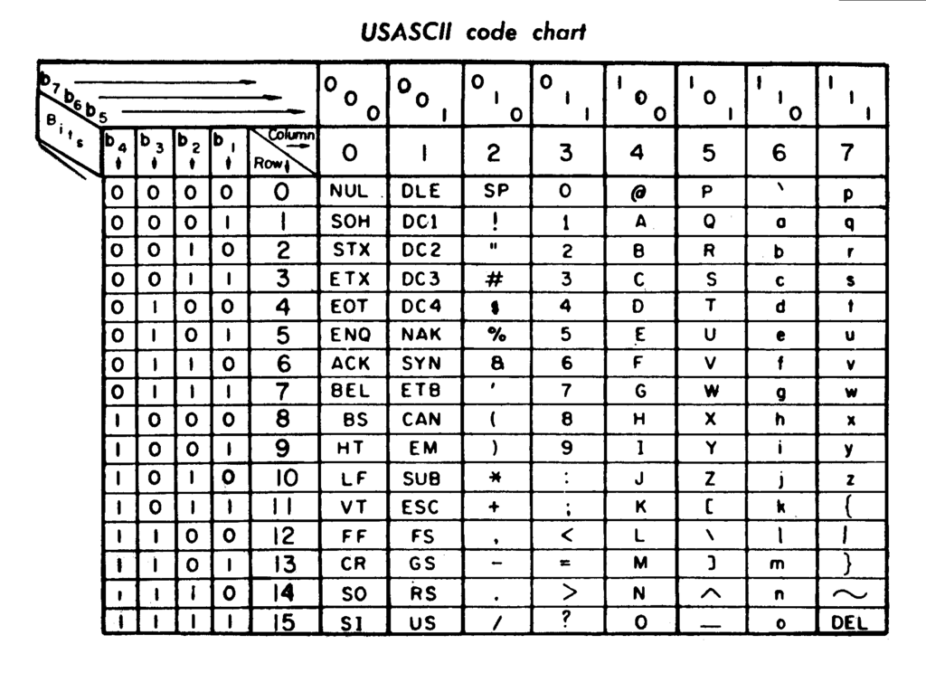
ASCII Character Coding
The American Standard Code for Information Interchange is one of the most widely used character sets. Each character is represented by a 7-bit codeword.
33 control characters
Back space, Delete, Escape
95 printable characters
Alphabetic, Numeric, Punctuation
A – 1000001 (65)

Slide 59
ISO/IEC 8859
ISO/IEC 8859 is a standard for 8 bit character encodings. It allows positions for another 96 printable characters (Latin alphabets)
ISO/IEC 8859 is divided into the following parts:
Part 1: Latin-1 Western European
Part 2: Latin-2 Central European
...
Part 16: Latin-10 South-Eastern European
Although Vietnamese uses Latin based characters, it doest not fit into 96 positions.

Slide 60
Unicode
Two mapping methods
Unicode Transformation Format (UTF)
UTF-8: 8 bit, variable-width length which maximizes compatibility with ASCII
UTF-16: 16 bit, variable-width length
UTF-32: 32 bit, fixed-width length
Universal Character Set (UCS)
UCS-2 is a subset of UTF-16
UCS-4 and UTF-32 are functionally equivalent
UTF-8 and UTF-16 are the most commonly used encodings (XML, HTML, Microsoft also recommends applications use UTF-8 or UCS-2/UTF-16)

Slide 61
Text Compression
Lossless compression
Statistical compression (e.g., Huffman coding)
Compression using dictionary (e.g., Lempel-Ziv)
These are intended for compressing natural language text and other data with a similar sequential structure.
These are used by general purpose compressors such as zip, bzip2, 7zip, etc.
Compression rate: approximately ½-2/3 document size

Slide 62
Huffman Coding
Huffman coding: A statistical compression technique, which needs a probability distribution as an input. The method for determining the probabilities is called a model, which can be static, semi-adaptive or adaptive.
A static model is a fixed model that is known by both the compressor and decompressor.
A semi-adaptive model is a fixed model that is constructed from the data to be compressed.
An adaptive model changes during the compression.

Slide 63
The Basic Algorithm
Not all characters occur with the same frequency.
Not all characters are allocated the same amount of space.
Codeword lengths are no longer fixed like ASCII.
Codeword lengths vary and will be shorter for the more frequently used characters.

Slide 64
The Basic Algorithm (Cont.)
Scan text to be compressed and tally occurrence of all characters.
Sort or prioritize characters based on number of occurrences in text.
Build Huffman code tree based on prioritized list.
Perform a traversal of tree to determine all codewords.
Scan text again and create new file using the Huffman codes.

Slide 65
Examples
Consider the following text:
BCAACADBDCADAEEEABACDBACADCBADABEABEAAA
A: 15; B: 7; C: 6; D: 6; E: 5
(39)
How about
Text Compression for Web Developers ?
0
1
A(15)
(24)
0
1
(13)
(11)
0
1
0
1
B(7)
C(6)
D(6)
E(5)

Slide 66
Lempel-Ziv Coding
Lempel-Ziv Coding relies on reoccurring patterns to save data space.
Example: Extended ASCII code – Every character is stored with 8 binary bit, allowing up to 256 unique characters for the data.
Lempel-Ziv tries to extend the library to 9 to 12 bits per character. The new symbols are made up of combination of symbols that occurred previously in the string. Lempel-Ziv do not compress well with short, diverse strings.

Slide 67
Examples
Consider the following text: ABCBCABCABCD
Previous Input | Input | Output | Symbol | Index
NIL | A
A | B | A | AB | 256
B | C | B | BC | 257
C | B | C | CB | 258
B | C
BC | A | BC | BCA | 259
A | B
AB | C | AB | ABC | 260
C | A | C | CA | 261
A | B
AB | C
ABC | D | ABC | ABCD | 262
D | EOL | D
Previous Input | Input | Output | Symbol | Index
NIL | A | A
A | B | B | AB | 256
B | C | C | BC | 257
C | 257 | BC | CB | 258
BC | 256 | AB | BCA | 259
AB | C | C | ABC | 260
C | 260 | ABC | CA | 261
ABC | D | D | ABCD | 262

Slide 68
Facsimile Image Compression
Dr. Quang Duc Tran

Slide 69
Compression Standards
ITU-T Group 1,2
Modulation: FM, AM, PM
White signal: 1300 Hz, 1500 Hz or Max carrier
Black signal: 2100 Hz, 2400 Hz or 26 dB max. lower
ITU-T Group 3: Fax machines are designed to operate with the PSTN (9600 baud).
ITU-T Group 4: Fax machines are designed to operate with the ISDN (64K baud).

Slide 70
ITU-T Group 3
Scan Direction: Left to Right, Top to Bottom
Scan Width: 215 (255, 303)
Pixels per Line: 1728 (2048, 2432)
Coding: RLC+MH (MMR - Group 4, Group 3 Option)
Compression Rate: 5%-20% of source (up to 95%)

Slide 71
Run Length Coding
Instead of sending long runs of ‘0’s or ‘1’s, it sends only how many are in the run.
70%-80% space is white on a typed character space, so RLE is useful.
In facsimile Data, there are many ‘0’s (white spots). Hence, it is possible to transmit the run-length as fixed size binary integer.
Best when there are many long runs of zeros. With increased frequency of ‘1’s, RLC becomes less efficient.

Slide 72
Run Length Coding (Cont.)
HHHHHHHUFFFFFFFFFYYYYYYYYYYYDGGGGG
Code = 7, H, 1, U, 9, F, 11, Y, 1, D, 5, G
SAVINGS IN BITS (considering ASCII): ?
11111111111000000000000011111
Code = 11, 1, 13, 0, 5,1
SAVINGS IN BITS: ?

Slide 73
Modified Huffman Coding
A run length of 1664 white pixels was assigned the short code 011000. Why is this length so common?
Modified Huffman Coding allows a run length, which is multiple of 64 pixels.
The run length can be either a single termination code or one or more make-up codes, followed by one termination code (if it is long)

Slide 74
Modified Huffman Coding (Cont.)
Run Length | White Code Word | Black Code Word
0 | 00110101 | 0000110111
1 | 000111 | 010
2 | 0111 | 11
3 | 1000 | 10
4 | 1011 | 011
5 | 1100 | 0011
… | … | …
61 | 00110010 | 000001011010
62 | 00110011 | 000001100110
63 | 00110100 | 000001100111

Slide 75
Modified Huffman Coding
Run Length | White Code Word | Black Code Word
64 | 11011 | 0000001111
128 | 10010 | 000011001000
192 | 010111 | 000011001001
256 | 0110111 | 000001011011
320 | 00110110 | 000000110011
384 | 0110111 | 000000110100
…
2432 | 000000011101 | Same as white
2496 | 000000011110 | Same as white
2560 | 000000011111 | Same as white

Slide 76
Modified Huffman Coding (Cont.)
A run length of 5 white pixels is coded as 1100
A run length of 69 white pixels: 64+5
A run length of 64 white pixels: 64+0
A run length of 2561 black pixels: 2560+1
EOL code: 000000000001

Slide 77
Modified Huffman Coding (Cont.)
There is no runs of length zero. Why then were codes assigned to runs of zero black and zero white pixels?
An 8.5 inch wide scan line results in 1728 pixels, so how can there be a run of 2561 consecutive pixels?
A run length of five black pixels is coded as 0011, which is also the prefix of the codes for run lengths of 61, 62, and 63 white pixels. Explain this.
What the compression ratio for runs of length one (i.e., strictly alternating pixels)?

Slide 78
STILL IMAGE
Dr. Quang Duc Tran

Slide 79
Image
All types of images are displayed in the form of a two-dimensional matrix of individual picture elements (pixels).
Pixel (RGB)

Slide 80
Color Models
RGB (Red, Green, and Blue) – Computer Monitors. RGBA is RGB with an additional channel, alpha, to indicate transparency.
CMYK (Cyan, Magenta, Yellow, and Black) – Photo printing.
YCbCr – Video capture system. YUV stores a luminance value along with two chroma values.
HSV – Artist. It is often more natural to think about color in terms of hue and saturation than additive and subtractive color components

Slide 81
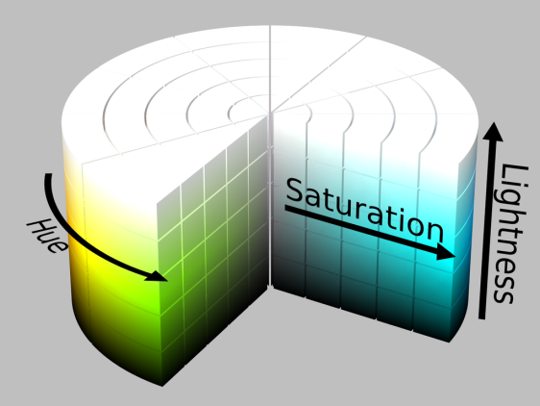
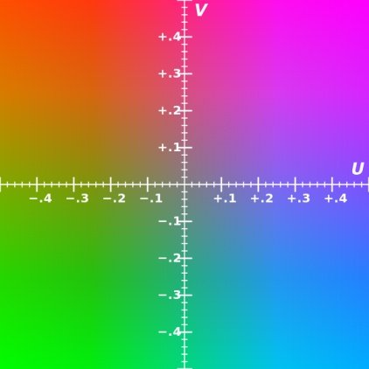
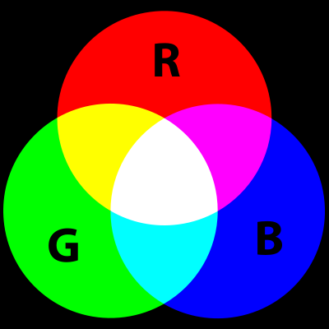
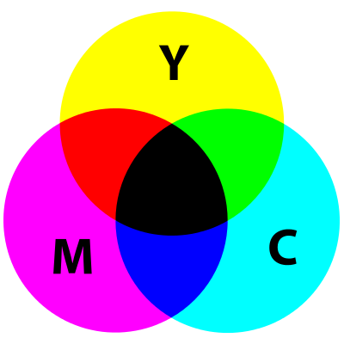
Color Models (Cont.)
HSV
YCbCr (Y=0.5)
RGB
CMYK

Slide 82
Color Models (Cont.)
YCbCr is not an absolute color space, it is a way of encoding RGB information. YCbCr contains perceptually meaningful information.
Y = 16+219(0.299R+0.587G+0.114B)/255
Cb = 128+224(-0.169R-0.331G+0.5B)/255
Cr = 128+224(0.5R-0.419G-0.081B)/255

Slide 83
Image Compression
Lossless Compression
Run-Length coding (RLC)
Huffman coding
Lempel-Ziv coding
Lossy compression
Transform coding
Chroma sub-sampling
JPEG

Slide 84
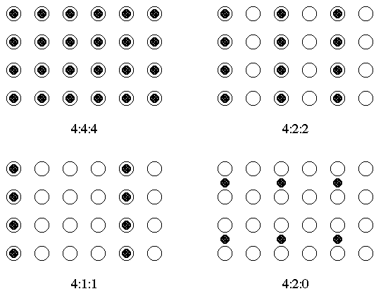
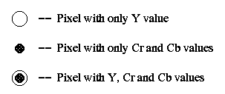
Chroma Sub-sampling

Slide 85
Chroma Sub-sampling (Cont.)
4:4:4 (1:1)
High end film scanners
Cinematic postproduction.
4:2:2 (3:2)
High end digital video formats and interfaces
4:1:1 (2:1)
DVCPRO (e.g., NTSC, PAL )
4:2:0 (2:1)
MPEG, H.26X video coding
DVD, Blue-ray Disc
JPEG, MJPEG

Slide 86
JPEG Standard
JPEG is an image compression standard that was developed by the “Joint Photographic Experts Group”.
JPEG is the most common format for storing and transmitting photographic images.
JPEG works with both color and grayscale images
The compression rate is typically 10:1 with little perceptible loss in image quality

Slide 87
JPEG Standard (Cont.)
JPEG is a lossy compression technique. It employs 2D-DCT (Discrete Cosine Transform) transform coding, whose effectiveness replies on 3 major observations:
Observation 1: Useful image contents change relatively slowly across the image.
Observation 2: Humans are much less likely to notice the loss of very high spatial frequency components than the loss of low frequency components.
Observation 3: Visual acuity (accuracy in distinguishing closely spaced lines) is much greater for gray than for color.

Slide 88
JPEG Coding
8×8 blocks
Entropy
Encoding
Compressed Image
FDCT
Quantization
Source Image
Quant. Table
Huffman Table
8×8 blocks
Entropy
Decoding
IDCT
Dequantization
Source Image
Quant. Table
Huffman Table

Slide 89
Discrete Cosine Transform
DCT transforms a signal of image from the spatial domain to the frequency domain.
DCT is similar to the Fast Fourier Transform (FFT) but can approximate lines well with fewer coefficients.
For most images, much of the signal energy lies at low frequencies, which appear in the upper left corner of the DCT
Compression is achieved since the lower right values represent higher frequencies, and are often small – small enough to be neglected with little visible distortion.

Slide 90
Discrete Cosine Transform (Cont.)
Both DC (i.e., F(0,0)) and AC (i.e., F(u,v) (u,v≠0)) coefficients contains integers, these can range from -1024 to 1023
52 | 55 | 61 | 66 | 70 | 61 | 64 | 73
63 | 59 | 55 | 90 | 109 | 85 | 69 | 72
62 | 59 | 68 | 113 | 144 | 104 | 66 | 73
63 | 58 | 71 | 122 | 154 | 106 | 70 | 69
67 | 61 | 68 | 104 | 126 | 88 | 68 | 70
79 | 65 | 60 | 70 | 77 | 68 | 58 | 75
85 | 71 | 64 | 59 | 55 | 61 | 65 | 83
87 | 79 | 69 | 68 | 65 | 76 | 78 | 94
-415 | -30 | -61 | 27 | 56 | -20 | -2 | 0
4 | -22 | -61 | 10 | 13 | -7 | -9 | 5
--47 | 7 | 77 | -25 | -29 | 10 | 5 | -6
-49 | 12 | 34 | -15 | -10 | 6 | 2 | 2
12 | -7 | -13 | -4 | -2 | 2 | -3 | 3
-8 | 3 | 2 | -6 | -2 | 1 | 4 | 2
-1 | 0 | 0 | -2 | -1 | -3 | 4 | -1
0 | 0 | -1 | -4 | -1 | 0 | 1 | 2
DCT

Slide 91
Quantization
Quantization discards information, which is not visually significant. It is fundamentally lossy and is the principal source of lossiness in DCT-based encoders.
Quantization step size should be chosen as a perceptual threshold, which is a function of the source image characteristic, display characteristic and viewing distance.
For a particular application, the best thresholds should be determined by performing psycho-visual experiments.
F^{Q}(u,v)=Integer Round (F (u,v)/Q(u,v))
Quantization step size

Slide 92
Quantization (Cont.)
It is typically the case that many of the higher frequency components are rounded to zero, and many of the rest become small positive or negative numbers, which take many fewer bits to represent.
16 | 11 | 10 | 16 | 24 | 40 | 51 | 61
12 | 12 | 14 | 19 | 26 | 58 | 60 | 55
14 | 13 | 16 | 24 | 40 | 57 | 69 | 56
14 | 17 | 22 | 29 | 51 | 87 | 80 | 62
18 | 22 | 37 | 56 | 68 | 109 | 103 | 77
24 | 35 | 55 | 64 | 81 | 104 | 113 | 92
49 | 64 | 78 | 87 | 103 | 121 | 120 | 101
72 | 92 | 95 | 98 | 112 | 100 | 103 | 99
-26 | -3 | -6 | 2 | 2 | -1 | 0 | 0
0 | -2 | -4 | 1 | 1 | 0 | 0 | 0
-3 | 1 | 5 | -1 | -1 | 0 | 0 | 0
-4 | 1 | 2 | -1 | 0 | 0 | 0 | 0
1 | 0 | 0 | 0 | 0 | 0 | 0 | 0
0 | 0 | 0 | 0 | 0 | 0 | 0 | 0
0 | 0 | 0 | 0 | 0 | 0 | 0 | 0
0 | 0 | 0 | 0 | 0 | 0 | 0 | 0
Increasing Frequency

Slide 93
Entropy Encoding
Entropy encoding is a special form of lossless data compression.
Entropy encoding involves arranging the image components in a zigzag order employing Run Length Coding (RLC) algorithm, inserting length coding zeros, and then using Huffman coding on what is left.
DC
DPCM
Huffman coding
F^{Q}(u,v)
01101…
AC
RLC

Slide 94
Zigzag Order
All of the quantized coefficients are ordered into the zigzag sequence. It places low frequency coefficients (which are more likely to be non-zero) before high-frequency coefficients.
-26 | -3 | -6 | 2 | 2 | -1 | 0 | 0
0 | -2 | -4 | 1 | 1 | 0 | 0 | 0
-3 | 1 | 5 | -1 | -1 | 0 | 0 | 0
-4 | 1 | 2 | -1 | 0 | 0 | 0 | 0
1 | 0 | 0 | 0 | 0 | 0 | 0 | 0
0 | 0 | 0 | 0 | 0 | 0 | 0 | 0
0 | 0 | 0 | 0 | 0 | 0 | 0 | 0
0 | 0 | 0 | 0 | 0 | 0 | 0 | 0
-26 | -3 | -6 | 2 | 2 | -1 | 0 | 0
0 | -2 | -4 | 1 | 1 | 0 | 0 | 0
-3 | 1 | 5 | -1 | -1 | 0 | 0 | 0
-4 | 1 | 2 | -1 | 0 | 0 | 0 | 0
1 | 0 | 0 | 0 | 0 | 0 | 0 | 0
0 | 0 | 0 | 0 | 0 | 0 | 0 | 0
0 | 0 | 0 | 0 | 0 | 0 | 0 | 0
0 | 0 | 0 | 0 | 0 | 0 | 0 | 0

Slide 95
DPCM & RLC
There are strong correlation between DC coefficients of adjacent blocks. Hence, the quantized DC is encoded as the difference from the DC term of the previous block in the encoding order by using DPCM.
RLC is applied to encode other AC coefficients
DC_{i-1}
DC_{i}
DIFF = DC_{i} - DC_{i-1}

Slide 96
DPCM & RLC (Cont.)
DC coefficient: +3 → (2),(3)
AC coefficients:
(0,2) (-3)
(1,2) (-3)
(0,2) (-2)
(0,3) (-6)
(0,2) (2)
…
(0,0) → EOB
AC coefficient is made up of a pair of symbols (run length, size) (amplitude). Run length is the number of zeros in the run. Size is the number of bits used to encode amplitude.
-26 | -3 | -6 | 2 | 2 | -1 | 0 | 0
0 | -2 | -4 | 1 | 1 | 0 | 0 | 0
-3 | 1 | 5 | -1 | -1 | 0 | 0 | 0
-4 | 1 | 2 | -1 | 0 | 0 | 0 | 0
1 | 0 | 0 | 0 | 0 | 0 | 0 | 0
0 | 0 | 0 | 0 | 0 | 0 | 0 | 0
0 | 0 | 0 | 0 | 0 | 0 | 0 | 0
0 | 0 | 0 | 0 | 0 | 0 | 0 | 0

Slide 97
Huffman Coding
Significant levels of compression can be obtained by replacing long string of a binary digit by a string of much shorter codeword.
The length of each codeword is a function of its relative frequency of occurrence.
JPEG provides general purpose Huffman tables, encoders may also choose to generate Huffman tables optimized for the actual frequency distributions in images being encoded.

Slide 98
Huffman Coding (Cont.)
Category | Values | Bits for the value
1 | -1,1 | 0,1
2 | -3,-2,2,3 | 00,01,10,11
3 | -7,-6,-5,-4,4,5,6,7 | 000,001,010,011,100,101,110,111
4 | -15,...,-8,8,...,15 | 0000,...,0111,1000,...,1111
5 | -31,...,-16,16,...31 | 00000,...,01111,10000,...,11111
6 | -63,...,-32,32,...63 | 000000,...,011111,100000,...,111111
7 | -127,...,-64,64,...,127 | 0000000,...,0111111,1000000,...,1111111
8 | -255,..,-128,128,..,255 | ...
9 | -511,..,-256,256,..,511 | ...
10 | -1023,..,-512,512,..,1023 | ...
11 | -2047,..,-1024,1024,..,2047 | ...
Values and bits for values

Slide 99
Huffman Coding (Cont.)
Run, category | Code Length | Codeword
0,0 | 4 | 1010
0,1 | 2 | 00
0,2 | 2 | 01
... | … | …
0,10 | 16 | 1111111110000011
1,1 | 4 | 1100
1,2 | 5 | 11011
… | … | …
15,10 | 16 | 1111111111111110
Luminance AC coefficients

Slide 100
Huffman Coding (Cont.)
Category | Code Length | Codeword
0 | 2 | 00
1 | 3 | 010
2 | 3 | 011
3 | 3 | 100
4 | 3 | 101
5 | 3 | 110
6 | 4 | 1110
7 | 5 | 11110
8 | 6 | 111110
9 | 7 | 1111110
10 | 8 | 11111110
11 | 9 | 111111110
Luminance DC coefficients

Slide 101
Huffman Coding (Cont.)
DC coefficient: +3 → (2),(3)
Encoded DC coefficient: 011 11
AC coefficients: (0,2) (-3), (1,2) (-3)… EOB
Encoded AC coefficient: 01 00 11011 00 … 00

Slide 102
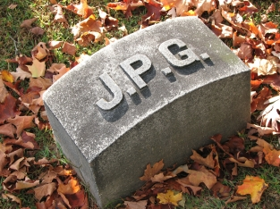




Example
1
2
3
Q = 100 - 83,2 bytes
Q = 50 - 15,1 bytes
Q = 25 - 9,5 bytes
Q = 10 - 4,7 bytes
Q = 5 - 1,5 bytes
4
5

Slide 103
Why another standard?
At low bit-rates (e.g., 0.25 bpp), the distortion in JPEG becomes unacceptable.
JPEG has 44 modes, many of them are not used by the majority of the JPEG encoders.
JPEG quality suffers dramatically, when bit errors are encountered during transmission.
JPEG is optimized for natural images and performs badly on graphics.
JPEG fails to compress bi-level (text) imagery.

Slide 104
JPEG2000
Dr. Quang Duc Tran

Slide 105
Key Features
Wavelet transform
Superior low bit-rate performance
Bi-level compression
Lossy and lossless compression
Robustness to bit errors
Scalability
Region of Interest

Slide 106
Operation Flow
Cut the image into non-overlapping tiles of equal size
Perform a component transformation
Process each tile of each component separately
Discrete Wavelet Transform
Quantization
EBCOT: Embedded Block Coding with Optimal Truncation
Comp. & Tile
DWT
Quantization
EBCOT
Image
1010….

Slide 107
Discrete Wavelet Transform
The signal x(n) is decomposed through a low and a high pass analysis filter, and subsample the filtering result by a factor of 2.
To reconstruct the original signal, a low and high pass coefficients are up-sampled by a factor of 2 and pass through another low and high pass synthesis filter pair.
Low-pass Analysis
2
2
Low-pass Synthesis
x(n)
x’(n)
High-pass Analysis
2
2
High-pass Synthesis

Slide 108
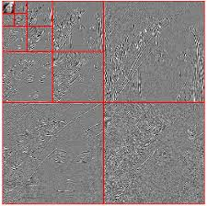
Discrete Wavelet Transform (Cont.)
To apply wavelet transform to a 2D array, such as an image, it is common practice to apply the wavelet transform in the horizontal and vertical direction separately.
2LL
2HL
1HL
2LH
2HH
1LH
1HH

Slide 109
Quantization
Quantization is performed to uniformly quantize all wavelet coefficients. This converts the wavelet coefficients from floating number into integer number.
The image coding quality is not determined by the quantization step size δ, but in the subsequent bit stream assembler. The value of δ is rather fine, e.g., δ =1/128.
Quantization result
Transform coefficient
Quantization step size

Slide 110
Quantization (Cont.)
The quantized coefficients are partition into packets. Each sub-band is divided into non-overlapping rectangles of equal size. Three rectangles correspond to the same space location at the three directional sub-bands HL, LH, HH of each resolution level comprise a packet.
The packet partition contains information needed for decoding image of a certain spatial region at a certain resolution.
The packet are further divided into non-overlapping code-blocks, i.e., fundamental entities of entropy coding.

Slide 111
Quantization (Cont.)
2HL
2LH
2HH
1
2
3
4
Dead zone
5
6
9
10
7
8
11
12
The default size of a code-block is 64x64
Small coefficients increase the quality of the image the least. A dead zone quantizer discards these coefficients

Slide 112
EBCOT
The packet partition contains information needed for decoding image of a certain spatial region at a certain resolution.
The packet are further divided into non-overlapping code-blocks, i.e., fundamental entities of EBCOT.
EBCOT is conceptually divided into two layers, called Tiers.
Tier 1 involves source modeling and entropy coding.
Tier 2 generates the output bit stream.

Slide 113
EBCOT (Cont.)
Code-block are coded by bit-plane, i.e., coefficient bits of the same order are coded together.
The most significant bits are coded first, then low order bits are coded in descending order.
Each bit-plane is coded independently. Bit-plane is further partitioned into three coding passes, i.e., significance propagation, magnitude refinement, and clean-up passes.
Each coding pass constitutes a code unit, called chunk.

Slide 114
EBCOT (Cont.)
b1 | b2 | b3 | b4 | b5 | b6 | b7 | S
0 | 1 | 0 | 1 | 1 | 0 | 1 | +
1 | 0 | 0 | 1 | 0 | 1 | 0 | -
0 | 0 | 1 | 0 | 1 | 0 | 1 | +
0 | 0 | 0 | 1 | 1 | 1 | 0 | +
0 | 0 | 0 | 0 | 1 | 0 | 0 | -
0 | 0 | 1 | 0 | 0 | 1 | 0 | -
0 | 0 | 0 | 0 | 1 | 0 | 0 | +
0 | 0 | 0 | 0 | 0 | 0 | 1 | -
45 | 0 | 0 | 0 | 0 | 0 | 0 | 0
-74 | -13 | 0 | 0 | 3 | 0 | 4 | 0
21 | 0 | 4 | 0 | 0 | 3 | 5 | 0
14 | 0 | 23 | 23 | 0 | 0 | 0 | 0
-4 | 5 | 0 | 0 | 0 | 1 | -1 | 0
-18 | 0 | 0 | 19 | -4 | 33 | 0 | -1
4 | 0 | 23 | 0 | 0 | 0 | 1 | 0
1 | 0 | 0 | 0 | 0 | 0 | 0 | 0
MSB
LSB

Slide 115
EBCOT (Cont.)
Chunks constitute valid truncation points.
Both encoder and decoder can truncate the bit stream in correspondence of a valid truncation point in order to recover the original data up to a target quality.
The output bit stream is made up by a number of packets containing chunks of the code-blocks in a given sub-band and belonging to the same layer.
Since packet header information is highly redundant, it is also compressed to reduce the packet overhead.

Slide 116

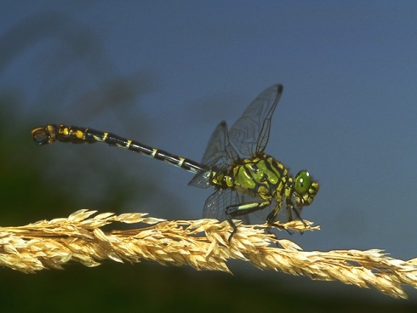


JPEG2000 Features
Lossless
5.2 bpp
Lossy
bit stream
Original image
Lower resolution
ROI
1.89 bpp

Slide 117
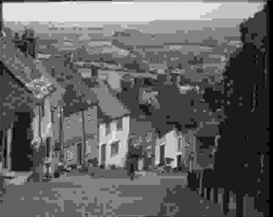
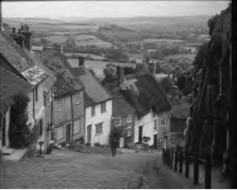
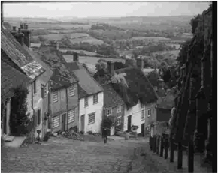
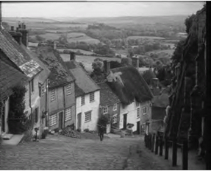
JPEG vs. JPEG2000
0.125 bpp
JPEG vs. JPEG2000
0.25 bpp

Slide 118
AUDIO
Dr. Quang Duc Tran

Slide 119
Sound Facts
Sound is a continuous wave that travels through the air. The wave is made up of pressure differences
Sound waves have normal wave properties (reflection, refraction, diffraction etc.)
Frequency represents the number of periods in a second and is measured in hertz (Hz) or cycles per second.
Amplitude is the measure of displacement of the air pressure wave from its means. It is related to but not the same as loudness.

Slide 120
Digital Audio
Audio signal that is encoded in digital form
Sampling
Quantization
Sampling rate
Telephone: 8 kHz
CD-audio: 44.1 kHz
Quantization
Speech: 8 bit
CD-audio: 16 bit
Number of sound tracks
Stereo: 2 channels
Professional: 16, 32 or more.

Slide 121
Digital Audio (Cont.)
Example 1: Sampling a four second sound of a speaking voice
Because the voice is in the lower range of the audio spectrum, we could sample the sound at 8 kHz with a mono channel and 8 bit resolution
Example 2: Sampling a four second sound of a musical selection
In order to capture the complex musical sound, the sampling rate should be 44.1 kHz. We will record a stereo sample with 16 bit resolution.

Slide 122
Audio Compression
Differential Pulse Code Modulation (DPCM)
Adaptive Differential Pulse Code Modulation (ADPCM)
Linear Predictive Coding (LPC)
Perceptual Coding
MPEG Audio Compression

Slide 123
DPCM
The range of differences in amplitudes between successive samples of the audio waveform is less than the range of the actual sample amplitudes. Hence, fewer bits to represent the difference signals.
Designing of DPCM is easy. Prediction is then based on the previously coded/transmitted samples.
Because the co-relation between successive are very good, so the output sample is far better than that of PCM.

Slide 124
DPCM (Cont.)
Speech
Input
Signal
AAF
ADC
Subtractor
Parallel-to-serial converter
Timing + Control
Register R
Adder
Network
Speech
Output
Signal
AAF
ADC
Register R
Adder
Serial-to-parallel converter
Timing + Control

Slide 125
DPCM (Cont.)
Encoder
Previous digitized sample is held in the register (R).
The DPCM signal is computed by subtracting the current content (R) from the new output by the ADC.
The register value is then updated before transmission.
Decoder
Decoder simply adds the previous register contents (PCM) with the DPCM.
Since ADC will have noise there will be cumulative errors in the value of the register signal.

Slide 126
Third-order predictive DPCM
Speech
Input
Signal
AAF
ADC
Subtractor
Parallel-to-serial converter
Adder
Timing + Control
C1
x
C2
x
C3
x
R1
R2
R3
Network
Speech
Output
Signal
AAF
ADC
Adder
Serial-to-parallel converter
Timing + Control
C1
x
C2
x
C3
x
R1
R2
R3

Slide 127
Third-order predictive DPCM (Cont.)
To eliminate the noise effect, predictive techniques are used to predict a more accurate version of the previous signal (i.e., using not only the current signal but also varying proportions of a number of the preceding estimated signals).
These proportions used are known as predictor coefficients.
Different signal is computed by subtracting varying proportion of the last three predicted values from the current output by the ADC

Slide 128
Third-order predictive DPCM (Cont.)
R1, R2, R3 will be subtracted from PCM.
The values in the R1 register will be transferred to R2 and R2 to R3 and the new predicted value goes into R1.
Decoder operates in a similar way by adding the same proportions of the last three computed PCM signals to the received DPCM signal.

Slide 129
Adaptive DPCM (ADPCM)
Saving of bandwidth is possible by varying the number of bits used for the difference signal depending on its amplitude.
An international standard for this is defined in ITU-T Recommendation G.721.
The principle is similar to that of DPCM except an eight-order predictor is used and the number of bits used to quantize each difference is varied.
Larger step-size is used to encode differences between high frequency samples and smaller step-size for differences between low frequency samples.

Slide 130
Sub-band ADPCM
Lower sub-band bandlimiting filter (50Hz-3.5 kHz)
Lower sub-band ADPCM encoder
48 kbps
Multiplexer
Speech
Input
Signal
Upper sub-band bandlimiting filter (3.5kHz-7kHz)
Upper sub-band ADPCM encoder
16 kbps
Network
Lower sub-band low-pass filter (50Hz-3.5 kHz)
Lower sub-band ADPCM decoder
48 kbps
Demultiplexer
Speech
Output
Signal
Upper sub-band low-pass filter (3.5kHz-7kHz)
Upper sub-band ADPCM decoder
16 kbps

Slide 131
Sub-band ADPCM
The sub-band ADPCM is defined in ITU-T Recommendation G.722 (better sound quality in VoIP).
This uses sub-band coding, in which the input signal prior to sampling is passed through two filters: one which passes only signal frequencies in the range 50 Hz through to 3.5 kHz and the other only frequencies in the range 3.5 kHz through to 7 kHz.
Each is then sampled and encoded independently using ADPCM. 6 digits are used to encode the lower sub-band signal, while 2 digits are used to encode the upper sub-band signal.

Slide 132
Linear Predictive Coding
Linear Predictive Coding derives its name from the fact that current speech sample can be closely approximated as a linear combination of past samples. The approximation is done on short chucks of the speech signal, called frames. Generally 30 to 50 frames per second give intelligible speech with good compression.
Order of the model
Prediction coefficient
Previous speech samples
Prediction error

Slide 133
Linear Predictive Coding (Cont.)
The predictor coefficients are determined by minimizing the sum of squared differences (over a finite interval) between the actual speech samples and the linearly predicted ones.
The higher the coefficient order p, the closer the approximation is.
Uncompressed speech is transmitted at 64 kbps. The LPC transmits speech at a bit rate of 2.4 kbps. There is a noticeable loss of quality, however, the speech is still audible.
LPC is used by phone companies (e.g., GSM standard).

Slide 134
Code-excited LPC (CELPC)
In CELPC model instead of treating each digitized frame independently for encoding purposes, just a limited set of frames are used, each known as a wave template.
A pre-computed set of templates are held by the encoder and the decoder in what is known as the template codebook.
Each of the individual digitized samples that make up a particular template in the codebook are differently encoded.

Slide 135
Perceptual Coding
LPC and CELPC are used for telephony applications. PC is designed for compression of general audio associated with a digital television broadcast.
Sampled frames of the source audio waveform are analyzed – but only those features that are perceptible to the ear are transmitted.
Although the human ear is sensitive to signals in the range 15 Hz to 20 kHz, the level of sensitivity to each signal is non-linear, i.e., the ear is more sensitive to some signals than others.

Slide 136
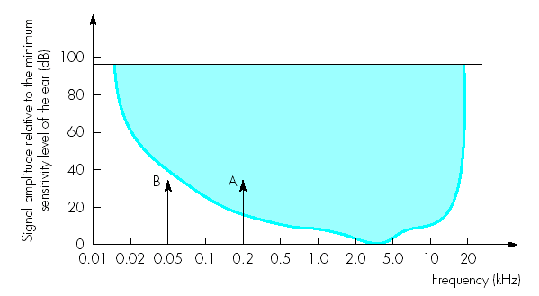
Sensitivity of the ear
Sensitivity of the ear varies with the frequency of the signal. The ear is most sensitive to signals in the range 2-5 kHz
The dynamic range of ear is defined as the loudest sound it can hear to the quietest sound.
Signal A is above the hearing threshold and B is below the hearing threshold

Slide 137
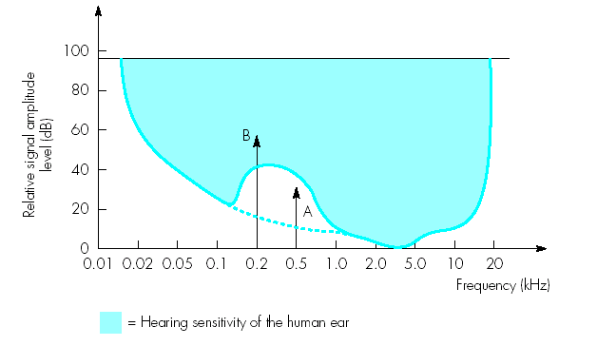
Frequency Masking
When multiple signals are present, a strong signal may reduce the level of sensitivity of the ear to other signals which are near to it in frequency
Signal B is larger than signal A. This causes the basic sensitivity curve to be distorted.
Signal A will no longer be heard as it is within the distortion band.

Slide 138
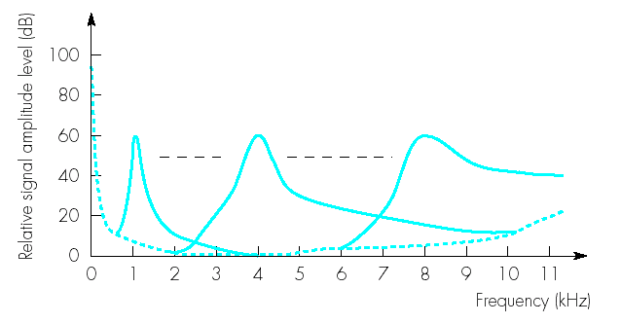
Frequency Masking (Cont.)
If the magnitude of the frequency components that make up an audio sound can be determined, it is possible to determine those frequencies that will be masked and do not need to be transmitted.
The width of each curve at a particular signal level is known as the critical bandwidth for that frequency.

Slide 139
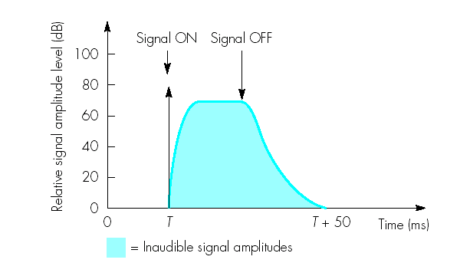
Temporal Masking
During this time, signals whose amplitudes are less than the decay envelope will not be heard and hence need not be transmitted.
After the ear hears a loud sound, it takes a further short time before it can hear a quieter sound. This is known as the temporal masking.

Slide 140
MPEG Audio Coder
Masking Threshold
Signal-to-mask ratios + Bit allocations
….…..
…...........
PCM
Encoder
1
Analysis filter bank (DFT)
Q1
Format frame for transmission
2
Q2
Speech
Input
Signal
…………………
…………………
…..…………..
32
Q32

Slide 141
MPEG Audio Coder (Cont.)
The bandwidth available for transmission is divided into 32 frequency sub-bands using a bank of analysis filters.
Processing associated with both frequency and temporal masking is carried out by the psychoacoustic model. A set of signal-to-mask ratios (SMR) is determined. This indicates the frequency components whose amplitude is below the audible components.
More bits are assigned for highest sensitivity regions compared with less sensitivity regions.

Slide 142
VIDEO
Dr. Quang Duc Tran

Slide 143
Analog Video
A video signal is a sequence of two dimensional (2D) images projected from a dynamic three dimensional (3D) scene onto the image plane of a video camera.
A video records the emitted and/or reflected light intensity from the objects. The intensity changes both in time and space.

Slide 144
Composite vs. Component Video
Ideally, a color video is specified by three function or signals, each describing one color component. A video in this format is known as component video.
In composite video, the three color signals are multiplexed into a single signal. A composite signal has bandwidth that is significantly lower than the sum of the bandwidth of three component signals, and hence, can be stored and transmitted efficiently. This is achieved at the expense of video quality.
S-video consists of two components, the luminance component and a single chrominance component.

Slide 145
Analog Video Raster
The analog TV systems of today use raster scan for video capture and display, which can be interlaced or progressive.
The progressive scanning scans an image sequentially from line 1 to the final line of the raster to create a video frame.
The interlaced scanning scans odd lines in field 1 and even lines in field 2. Together field 1 and 2 constitute one frame.

Slide 146
Refresh rate
The frequency between the display of two still images is known as the refresh rate and is expressed in Hz or frames per second.
The movie industry uses a refresh rate of 24 frames per second.
For a fix bandwidth, the interlaced scan provides a video signal with twice the display refresh rate for a given line count as compared to the progressive scan. This higher refresh rate improves the appearance of objects motion.
However, interlaced scan causes interlacing effects if recorded objects move fast to be in different positions when each individual field is captured.

Slide 147
Analog Television System
HDTV enhances the visual impact by employing a wider screen (16:9) and sampling resolution of 60 frames/s, and 720 line/frame.
For computer display, much higher temporal and spatial sampling rates are needed (e.g., SVGA has 72 fps and a resolution of 1024x720 pixels).
Parameters | NTSC | PAL | SECAM
Field Rate | 59.94 | 50 | 50
Line No./Frame | 525 | 625 | 625
Line Rate (Line/s) | 15,750 | 15,625 | 15,625
Luminance Bandwidth (MHz) | 4.2 | 5.0, 5.5 | 6.0
Chrominance Bandwidth (MHz) | 1.5 (I), 0.5 (Q) | 1.3 (U,V) | 1.0 (U,V)
Audio Subcarrier | 4.5 | 5.5, 6.0 | 6.5
Composite Signal Bandwidth (MHz) | 6.0 | 8.0, 8.5 | 8.0

Slide 148
Digital Video
A digital video can be obtained either by sampling a raster scan, or directly using digital video camera.
In the BT. 601 standard, a sampling rate of 13.5 MHz is used for both the NTSC and PAL/SECAM systems.
BT.601 also defines a digital color coordinate, known as YCbCr (see Chroma Sub-sampling).
In addition to BT.601, other standards exists. For example, CIF (Common Intermediate Format) has about half the resolution of BT.601.

Slide 149
Video Compression
International Telecommunication Union (ITU-T)
H.261: ISDN Video Phone (px64 kb/s)
H. 263: PSTN Video Phone (<64 kb/s)
H.26L: A variety of applications (<64 kb/s)
Internet Video Application, VOD, Video Mail
International Organization for Standard (ISO)
MPEG-1 Video: CD-ROM (1.2 Mb/s)
MPEG-2 Video: SDTV, HDTV (4-80 Mb/s)
MPEG-4 Video: A variety of applications (24-1024 kb/s)
MJEG (Moving JPEG) applies JPEG algorithm to each frame independently.

Slide 150
Video Compression (Cont.)
A video stream has 2 spatial and 1 temporal dimensions, video compression is usually done independently in the spatial dimensions and, respectively, in the time dimension.
In the spatial dimensions – encoder tries to eliminate spatial redundancy (like in JPEG) and typically works on 8x8 pixel image blocks.
In the time dimension – encoder tries to eliminate temporal redundancy (i.e. motion of objects) and typically works on 16x16 pixel image blocks.

Slide 151
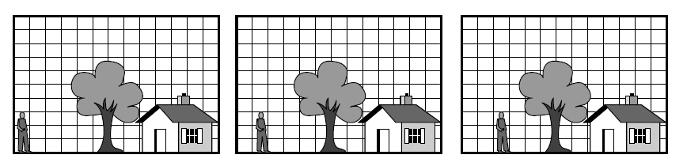
Motion Estimation
The references between the different types of frames are realized by a process called motion estimation. The correlation between two frames in terms of motion is represented by a motion vector.

Slide 152
Motion Estimation (Cont.)
Good estimation of the motion vector results in higher compression ratios and better quality of the coded video sequence.
The actual frame is divided into non-overlapping blocks (macro blocks) usually 16x16 pixels. The smaller the block sizes are chosen, the more motion vectors need to be calculated.
Motion vectors are only calculated if the difference between two blocks at the same position is higher than a threshold.

Slide 153
Motion Estimation (Cont.)
Block Matching tries to “stitch together” an actual predicted frame by using blocks from previous frames.
Each blocks of the current frame is compared with a past frame within a search area.
Rectangular search area is used, which takes into account that horizontal movements are more likely than vertical ones.
Only luminance information is used to compare the blocks, but color information will be included in the encoding.

Slide 154
Motion Compensation
Video motions are often complex. A simple “shifting in 2D” is not a perfectly suitable description of the motion in the actual scene, causing so called prediction errors.
Since the estimation is not exact, additional information must also be sent to indicate any small differences between the predicted and actual positions of the moving segments involved. This is known as the motion compensation.
Generally, less data is needed to store the differences.

Slide 155
Schematic Process of Motion Estimation
Current
Frame
DCT
Quantization
Entropy
Coding
Bit stream
Motion Compensation
Reference
Frames
Frame N-1
Motion Estimation
Frame N
Motion Vector

Slide 156
MPEG Standards
MPEG-1: Initial Audio/Video Compression Standard
Total bit rate: 1.5 Mbps
Video: 352x240 pixels/frame, 30 frames/s
Audio: 2 channels, 48,000 samples/s, 16 bits/sample
MPEG-2: for better quality audio and video
Total bit-rate: 4-80 Mbps
Video: 720x480 pixels/frame, 30 frames/s
Audio: 5.1 channels, Advanced Audio Coding (AAC)
MPEG-4: for a variety of applications with a wide range of quality and bit rate

Slide 157
A Typical MPEG Frame Display Order
Forward Motion Compensation
I
B
B
P
B
B
P
B
B
I
Bidirectional Motion Compensation
I-frame: Intra-coded frame
P-frame: One directional motion prediction from a previous frame
B-frame: Bi-directional motion prediction from a previous or future frame

Slide 158
I-frames
I-frames are encoded without reference to any other frames. Each frame is treated as a separate picture and the Y, C_{b} and C_{r} matrices are encoded separately using JPEG
I-frames must be repeated at regular intervals to avoid losing the whole picture as during transmission it can get corrupted and hence looses the frame
The number of frames/pictures between successive I-frames is known as a group of pictures (GOP). Typical values of GOP are 3 - 12

Slide 159
P-frames
The encoding of the P-frame is relative to the contents of either a preceding I-frame or a preceding P-frame
P-frames are encoded using a combination of motion estimation and motion compensation
If the two contents are the same, only the address of the macro block in the reference frame is encoded
If the two contents are very close, both the motion vector and the difference matrices associated with the macro block in the reference frame are encoded.
If no close match is found, then the target macro block is encoded in the same way as a macro block in an I-frame
Number of P frames between I-frames is limited to avoid error propagation

Slide 160
B-frames
Motion estimation works well in slow moving applications like video telephony
For fast moving video it will not work effectively. Hence B-frames (Bi-directional) are used. Their contents are predicted using the past and the future frames
B-frames provides highest level of compression and because they are not involved in the coding of other frames they do not propagate errors

Slide 161
MPEG-1 Encoder

Slide 162
MPEG-1 Decoder

Slide 163
MPEG-1 Performance
Compression for I-frames are similar to JPEG for Video typically 10:1 through to 20:1 depending on the complexity of the frame contents
P and B frames are higher compression and in the region of 20:1 through to 30:1 for P frame and 30:1 to 50:1 for B-frames

Slide 164
MPEG-1 Bit stream structure
Video sequence #n-1
Video sequence #n
Video sequence #n+1
Sequence
Header
GOP #p
GOP #p+1
GOP #p+2
GOP #p+3
GOP #p+4
GOP #p+5
GOP
Header
Frame I
Frame B
Frame B
Frame P
…
Frame
Header
MB
MB
MB
MB
MB
MB
MB
MB
MB
MB
MB
MB
MB
MB
Slide
Header
Motion Vector
Block Y
Block Y
Block Y
Block Y
Block C_{b}
Block C_{r}
MB
Header

Slide 165
MPEG-2 Standard
MPEG-2 is a higher-quality video coding standard at a bit rate of more than 4 Mbps for video on demand (VOD), standard definition (SD) and high-definition (HD) digital TV broadcasting and for storing video on digital storage media like the DVD
MPEG-2 supports interlaced video and alternative scan order.
MPEG-2 have scalable coding and include error resilience techniques

Slide 166
MPEG-2 Interlaced Scan
Progressive Scan
Interlaced Scan

Slide 167
MPEG-2 Alternative Scan Order
Zigzag scan
Alternate scan
Alternative scan order may improves the effectiveness of DCT on prediction errors. This is due to the fact that in interlaced video, the consecutive rows in the blocks are from different fields. Hence there is less correlation between them than between the alternative rows.

Slide 168
MPEG-2 Scalable Coding
Scalable coding divides the audio-video stream into a base layer and some enhancement layers
When the base layer is decoded basic quality is achieved, but if the transmission channel allows it, decoding enhancement layers brings additional quality to the decoded stream.
The types of scalability can be SNR scalability, spatial scalability, temporal scalability or hybrid (combination of the above).

Slide 169
MPEG-4 Standard
MPEG-4 is used for interactive multimedia applications over the Internet and over various entertainment networks.
MPEG standard contains features to enables the manipulation of the individual elements that make up a scene within a video.
In MPEG-4 each video frame is segmented into a number of video object planes (VOP) each of which will correspond to an AVO (Audio visual object) of interest.

Slide 170
MPEG-4 Standard (Cont.)
Each audio and video object has a separate object descriptor associated with it, which allows the object to be manipulated by the viewer prior to it being decoded and played out.
Before being compressed each scene is defined in the form of a background and one or more foreground audio-visual objects (AVOs).
The audio associated with an AVO is compressed depending on the available bit rate of the transmission channel and the sound quality required.

Slide 171
MPEG-4 Standard (Cont.)
Transmission Multiplexer
VOP 0 encoding
VOP
Identification + Definition
VOP 1 encoding
Video Input
VOP 2 encoding
Audio Input
Audio encoding

Slide 172
MULTIMEDIA NETWORKING SYSTEM
Dr. Quang Duc Tran

Slide 173
User Requirements
Fast preparation and presentation of the different multimedia types of interest, taking into account the capabilities of available terminals and services.
Dynamic control of multimedia applications with respect to connection interactions and quality on demand, combined with user-friendly interfaces.
Intelligent support of users, taking into consideration their individual capabilities.

Slide 174
Network Requirements
High speed and changing bandwidth
Multimedia applications, particularly those using video and images demand large bandwidth. However, bandwidth for the foreseeable future will be limited. The limitation arise from the cost of installing optical fiber transmission, terminal equipment complexity and speed, etc.
Quality of Services
The availability of multimedia sources places demands on the service that a network must provide. The most importance of these are the bit error rate, the packet or cell loss, delay and delay variation.

Slide 175
Network Requirements (Cont.)
Synchronization of different information types
Multimedia synchronization refers to temporal relationships between the media objects. A common example of temporal relationship is movie or television, where both audio and video objects are involved.
Reliable security features and firewalls
Security features include digital watermarking, data hiding, multimedia content protection, biometrics, multimedia human-computer interface.
Firewall refers to a system, which controls the incoming and outgoing network traffic based on an applied rule set.

Slide 176
MULTIMEDIA NETWORKS
Dr. Quang Duc Tran

Slide 177
Multimedia Networks
Wide-Area Network (WAN)
Typically, a WAN consists of a number of interconnected switching nodes. It covers a broad area using leased telecommunication lines. Conventionally, WANs have been implemented using one of two technologies, i.e., circuit switching and packet switching.
Local Area Network (LAN)
A LAN interconnects computers within a limited area. Hence, the scope of LAN is typically a single building or a cluster of buildings. The internal data rates of LANs are much greater than those of WANs.

Slide 178
LAN Technology
Features | FDDI | Ethernet | Token Ring
Transmission rate | 125 MBAUD | 20 MBAUD | 8 & 32 MBAUD
Data rate | 100 Mbps | 10 Mbps | 4 & 16 Mbps
Signal encoding | 4B/5B 80% Efficient | Manchester 50% Efficient | Diff. Manchester 50% Efficient
Maximum coverage | 100 km (UTP, Fiber) | 2.5 km (Coax., UTP, Fiber) | Configuration dependent
Maximum nodes | 500 | 1024 | 250
Maximum distance between nodes | 2 km (MMF) 40 km (SMF) | 2.5 km | 300 m recommended 100 m
FDDI: Fiber Distributed Data Interface

Slide 179
FDDI Properties
FDDI uses a ring topology of multimode or single mode optical fiber transmission links operating at 100 Mbps to span up to 100 km and permits up to 500 stations.
To accommodate a mixture of stream, FDDI is designed to handle two types of traffic:
Synchronous frames that typically have tighter delay requirements (e.g., voice and video).
Asynchronous frames that have greater delay tolerances (e.g., data traffic).
FDDI uses TTRT (Target Token Rotation Time) to ensure that token rotation time is less than some value.

Slide 180
FDDI Layers
Station Management
(SMT)
Logical Link Control (LLC)
Data Link Layer
Media Access Control (MAC)
Physical (PHY)
Physical Layer
Physical medium dependent (PMD)

Slide 181
FDDI Layers
Physical Layer provides the media independent functions associated with the OSI physical layer. Its functionalities also include decoding and encoding (PMD to a symbol stream and data and control symbols to PMD).
MAC layer provides fair (i.e., no node has higher priority than others in accessing the medium) and deterministic access (i.e., under error-free conditions, the time a node has to wait to access the medium can be predicted)
SMT is a sophisticated, build in network monitoring and management capabilities. It is not an OSI-RM specification.

Slide 182
FDDI Advantages
High Bandwidth (100 Mbps)
Large distance between FDDI nodes because of very low attenuation (≤0.3 dB/km) in fibers.
Improved Signal-to-Noise ratio because of no interference from external ratio frequencies and electromagnetic noise
Bit error rate (10⁻¹¹) is substantially better than that in Copper (10⁻⁵) and microwave system (10⁻⁷).
Very difficult to tap signal from a fiber cable.

Slide 183
FDDI Limitations
High cost of optical components required for transmission/reception of signals (especially for single mode fiber network)
More complex to implement than existing low speech LAN technologies such as Ethernet and Fast Ethernet.

Slide 184
WAN Technology
Public Switched Telephone Network (PSTN)
Integrated Service Digital Network (ISDN)
Broadband ISDN
Wireless Network (note: wireless LAN)
Broadcast Channel: Terrestrial, Cable, Satellite.

Slide 185
PSTN
Now known as Plain Old Telephone Service (POTs)
The term switched means a subscriber can make a call to any other telephone on the ‘total’ network.
The copper wire between the home and central office has a limited bandwidth (56 Kbps). This is still too low for carrying video with pleasing quality.
Higher data rates, up to 6 Mbps in the downlink direction are possible with ADSL (Asymmetric Digital Subscriber Loop) modems. ADSL is one of the main transport media for streaming MPEG-1, MPEG-2 movies through VOD services.

Slide 186
ISDN
ISDN is the first network using digital transmission. The data rate can be multiples of basic channels (B channels) of 64 Kbps each, with multiplying factor ranging from 1 to 24.
The basic subscription of ISDN comes with a 2B+D channel, where D channel is 16 Kbps and is used for return signaling. At 128 Kbps, very low quality video can be achieved.
ISDN connection is very reliable. H.320 (i.e., the first recommendation series for audio-video conferencing) was developed for ISDN.

Slide 187
Broadband ISDN
B-ISDN services offer H.0 channels (384 Kbps), H.11 channels (1.536 Mbps) and H.12 channels (1.920 Mbps). This requires higher bandwidth coaxial cable or optical fiber.
B-ISDN uses Asynchronous Transfer Mode (ATM) packet switching with fixed size packets (known as cells). The very short cell size (53 Bytes with 48 Bytes payload) makes B-ISDN suitable for real-time applications with low delay requirements.
Cell loss can occur due to traffic congestion, although the loss (10⁻⁶-10⁻⁴) is quite low for video services.

Slide 188
Why the Cell Size is 53 Bytes?
The cell size is determined as a trade-off between packetizing delay and cell overhead. Generally, cell overhead (waste) is smaller at larger payload sizes.
However, small cell size is preferred because of cell loss. For example, a 53 Bytes cell contain 48 voice samples, which is only 48 x 125 µs = 6 ms of voice. The loss of a cell would be almost unnoticed. However, a loss of cell with 32 ms of voice would be very disruptive.
32 Byte is the maximal payload size, at which there is no noticeable packetizing delay, but the overhead would be 13.5%. 64 Bytes payload would produce a small echo in voice communication, but the overhead would be 7.1%.

Slide 189
ATM Service Categories
Constant Bit Rate (CBR)
CBR supports real-time applications that require tightly constrained delay and delay variation (e.g., video conferencing, telephone call, video/audio distribution).
Variable Bit Rate (VBR)
Real-time VBR supports real-time applications, but may allow more efficient use of a network.
Non Real-time VBR supports real-time applications, which are more tolerant of network delays (e.g., airline reservations, banking transactions, process monitoring)

Slide 190
ATM Service Categories (Cont.)
Available Bit Rate (ABR)
ABR is a best effort service, which supports non real-time applications that allow congestion control because the sender can be informed to slow down the traffic in congestion periods (e.g., critical data transfer, text/data/image retrieval and distribution, remote terminal).
Unspecified Bit Rate (UBR)
UBR is a best effort service without any performance requirement. UBR is equivalent to Internet.

Slide 191
Wireless Network
Network | Data Rate | Mobility | Range | Channel Quality
Cellular Network | <20 Kbps | High | 2.5 km | Poor
Wireless Data Network | 64-384 Kbps | High | 2.5 km | Poor
Wireless LAN | 2-25 Mbps | Low (Indoor) | 50 m | Location dependent
Wireless IP Network | 1-600 Mbps downlink | Low (Indoor) | 3-30 miles | Good
Cellular Network: GPRS, EDGE (8.8-59.2 Kbps)
Wireless Data Network: 3G (BER <10⁻⁶)
Wireless IP Network (2.15-40 GHz): MMDS (1 Mbps), LMDS (600 Mbps)

Slide 192
Wireless Network (Cont.)
Difficulties for video transport over wireless networks lie in the low bandwidth, high error rate, and most importantly, the fluctuation of available bandwidth and error characteristics.
For real-world applications, quite sophisticated FEC (Forward Error Check) codes are used to reduce the bit error rates significantly.
Most wireless interactive multimedia communication systems employ H.223. H.223 conveys media data including compressed video in the form of packets of variable size. Typical packet sizes are around 100 bytes to ensure good delay characteristics.

Slide 193
3G Wireless System
3G provide higher data rates by using higher carrier frequencies, wider bandwidth and more sophisticated techniques for multiple access, error control, and signal detection.
BER for data transmission is below 10⁻⁶.
Generally, wireless channel is quite noisy with high bit error rates. But the use of rate adaptation, FEC and ARQ yield an almost error-free environment for data transmission. For video transmission, where ARQ has to be limited, one has to cope with quite high bit error rates and packet loss rates.

Slide 194
Broadcast Channels
This is used for broadcasting of digital TV including HDTV using the MPEG-2 video coding and transport streams.
The compressed data are carried over packets of 188 bytes each. The MPEG-2 transport layer ensure an almost error free environment.
For SDTV, the available bandwidth is between 3-10 Mbps. For HDTV, 20 Mbps is typically allocated.

Slide 195
Video Application Characteristics
Application and Standard Family | Multiplex Protocol | Video Coding Standard | Bit Rate | Error Characteristics
ISDN Video Phone (H.320) | H.221 | H.261 and H.263 | 64-384 Kbps | Error free
PSTN Video Phone (H.324) | H.223 | H.263 | 20 Kbps | Very low
Mobile Video Phone (H.324 wireless) | H.223 | H.263 | 10-300 Kbps | BER = 10⁻⁵-10⁻³ Occasional packet loss
Video Phone over Packet network (H.323) | H.225/RTP/ UDP/IP | H.261 H.262 H.263 | 10-1000 Kbps | BER = 0, 0-30% packet loss
Satellite TV | MPEG-2 System | MPEG-2 | 6-12 Mbps | Almost error free
Video conferencing over ATM (H.320, H.321) | H.222 | H.262 | 1-12 Mbps | Almost error free
H.262 is identical to MPEG-2 video, H.222 is identical to MPEG-2 system

Slide 196
QUALITY OF SERVICE
Dr. Quang Duc Tran

Slide 197
End-user QoS Categories Mapping
Error Tolerant
Conversation Voice and Video
(FER <3%)
Voice/Video Messaging
(FER < 3%)
Streaming Audio and Video
(FER < 1%)
Fax
(BER<10⁻⁶)
Error Intolerant
Command Control (e.g., Telnet)
Transactions (e.g., E-commerce)
Messaging Downloads (e.g., FPT)
Background (e.g., Email arrival)
Interactive
(delay << 1s)
Responsive
(delay ~ 2s)
Timely
(delay ~ 10s)
Non-critical
(delay >> 10s)
ITU-T G.1010 Standard

Slide 198
End-user Performance Expectations (Conversational Services)
Media | Application | Degree of Symmetry | Data Rate | Performance Parameters
 |  |  |  | One-way Delay | Delay Variation | Information Loss
Audio | Conversation Voice | Two-way | 4-25 Kbps | < 150 ms preferred < 400 ms | < 1 ms | < 3% FER
Video | Video Phone | Two-way | 32-384 Kbps | < 150 ms preferred < 400 ms Lip synch. < 100 ms |  | < 1% FER
Data | Interactive Games | Two-way |  | < 250 ms | N/A | Zero
Data | Telnet | Two-way |  | < 250 ms | N/A | Zero

Slide 199
Conversation Voice
The preferred range of audio transfer delay is 0-150 ms (below 30 ms the user does not notice any delay at all).
There are three types of satellite systems: LEO, MEO, and GEO. For LEO and MEO, the propagation delay for transmitted signal varies from 10 ms to 250 ms . A GEO system cannot achieve an end-to-end delay below 250 ms .
The human ear is highly intolerant to short-term delay variation (jitter) so it should be kept really low (< 1 ms).

Slide 200
Video Phone
Video Phone requires a full-duplex system, carrying both video and audio. The same delay requirements of conversation voice will be applied with added requirement that audio and video must be synchronized within certain limits to provide ‘lip-synch’.
Human eye is tolerant to some information loss, and hence, some degree of packet loss is acceptable.

Slide 201
End-user Performance Expectations (Interactive Services)
Media | Application | Degree of Symmetry | Data Rate | Performance Parameters
 |  |  |  | One-way Delay | Delay Variation | Information Loss
Audio | Voice Messaging | Primarily One-way | 4-13 Kbps | < 1 s playback < 2 s record | < 1 ms | < 3% FER
Data | Web-browsing HTML | Primarily One-way |  | < 0.5 s/page preferred < 4 s/page | N/A | Zero
Data | Transaction services | Two-way |  | < 4 s | N/A | Zero
Data | Email (Server Access) | Primarily One-way |  | < 4 ms | N/A | Zero

Slide 202
End-user Performance Expectations (Streaming Services)
Media | Application | Degree of Symmetry | Data Rate | Performance Parameters
 |  |  |  | One-way Delay | Delay Variation | Information Loss
Audio | Speech, Music | Primarily One-way | 5-128 Kbps | < 10 s | < 2 s | < 1% Packet Loss Ratio
Video | Movie clips, Real-time video | Primarily One-way | 1-12 Mbps | < 10 s | < 2s | < 2% Packet Loss Ratio
Data | Data Transfer | Primarily One-way | < 384 Kbps | < 10 s | N/A | Zero
Data | Still image | Primarily One-way |  | < 10 s | N/A | Zero

Slide 203
Queuing and Scheduling
First In First Out (FIFO)
There is a single queue and data is served according to its own arrival time. Hence, high priority packets may get stuck behind low priority packets.
Aggressive flows obtain better performances because they fill more the queue.
Priority Scheduling
Delay, jitter and loss are reduced for the high priority traffic at the cost of starving the lower priority traffic.
A parameter may be assigned to each priority queue, which determines the extend, to which the priority queue is served.

Slide 204
Queuing and Scheduling (Cont.)
Weighted Fair Queuing (WFQ)
All traffic is classified into the so-called traffic classes, which can be either individual flows or a bunch of flows with similar transmission requirements.
A share of bandwidth for each class is provided in proportion to its specified rates.
Round Robin
Buffer is organized in separate queues (each implemented FIFO) for each flow and a single packet is selected at time from queues with a circular mode.

Slide 205
Congestion Control & Queue Discard
Tail Drop
Tail Drop drops arriving packets when buffers in queue are full. It may lead to network meltdown due to TCP global synchronization.
Random Early Discard (RED)
RED is more fair than tail drop because it does not posses a bias against traffic that uses only a small portion of the bandwidth. The more host transmits, the more likely it is that its packets are dropped .
Weighted Random Early Discard (WRED)
A variant of RED, which attempts to weight queues for random early discard.
Tri-Color Marking

Slide 206
Best-Effort
Best-effort does not provide QoS because there is no ordering of packets.
In a best-effort network, all users obtain unspecified variable bit rate and delivery time, depending on the current traffic load.
The internet protocol offers a best-effort service of delivering data between hosts, which can be lost, delayed, corrupted or duplicated.

Slide 207
Integrated Services
Integrated Services (IntServ) makes strict bandwidth reservations. It must be configured on every router along a path.
Each application that requires a service guarantee has to make a reservation by using Resource Reservation Protocol (RSVP) signaling.
When bandwidth is reserved for a certain application, it cannot be reassigned for another application.

Slide 208
Integrated Services (Cont.)
Routers between the sender and the receiver determine whether they can support the reservation made by the application.
The task of reserving paths would be very tedious in a busy network such as the Internet.
The main drawback of IntServ is its lack of scalability (Routers have to classify, police and queue each flow). Moreover, many Internet flows are short-lived, and hence, not worth setting up Virtual Channel.

Slide 209
IntServ Mechanism
Provide the network with a set of information, known as Flow Specs. Flow Specs include Traffic Specification (TSPEC) and Request Specification (RSPEC).
TSPEC describes the flow traffic characteristics. RSPEC describes the service request (request for controlled traffic and/or delay bound).

Slide 210
Inserv Mechanism (Cont.)
Admission Control asks the network to provide particular services. The decision may be based on heuristics (e.g., “Last time I allowed a flow with the TSPEC but the delay exceeded the acceptable bound, hence I would say no”).
For admission control, the so-called Token Bucket Filter only passes packets arriving at a rate which is not exceeding some administratively set rate, but with possibility to allow short bursts in excess of this rate.

Slide 211
Inserv Mechanism (Cont.)
Application and network exchange information to request services, flow specs and admission control by using the Resource Reservation Protocol (RSVP).
Each packet is mapped into a class service, which determine how the packet is scheduled and handled. Typically, the WFQ should be considered to provide a guaranteed end-to-end delay.

Slide 212
Soft State
Per Session State (Path state, reservation state) has a timer associated with it. State lost when timer expires.
Senders and Receivers periodically refresh the state, resend PATH/RESV messages, reset timer.
State can be explicitly deleted by a Teardown message.
Soft-State is useful for efficiency, but not essential. It supports dynamic automatic adaptation to network changes.

Slide 213
RSVP
RSVP allows applications running in hosts to reserve resources in the Internet for their data flows.
RSVP must be present in the receivers, senders and routers.
RSVP provides reservations for bandwidth in multicast trees. It is also receiver-oriented, i.e., receiver initiates and maintains the resource reservation for data flows.
RSVP is not routing protocol, sometimes referred to as a signaling protocol.

Slide 214
RSVP Mechanism
Sender sends PATH message to let the routers know on which links they should forward the reservation (RESV) message. PATH message contains TSPEC and specifies source traffic characteristics (max. bandwidth, token bucket size and max. packet size).
Receiver requests for resources using RESV message. There are three reservation styles, which can be Fixed-filter, Wildcard-filter and Shared-explicit.

Slide 215
RSVP Mechanism (Cont.)
Fixed-filter style
It specifies a list of senders from which it wants to receive a data flow along with a single bandwidth reservation. This reservation is not shared.
Wildcard-filter style
It tells the network that it wants to receive all flow from all senders and the bandwidth reservation is shared among the senders.
Shared-explicit style
It specifies a list of senders from which it wants to receive a data flow along with a single bandwidth reservation. This reservation is shared among all the senders in the list.

Slide 216
Differential Services
DiffServ does not require nodes in the network to remember state information in the routers. Remembering state information and reserving paths in a busy network (Internet) may be a tedious task.
Differential Services (DiffServ) provides a improved level of service in the existing best-effort environment by differentiating traffic flow.
DiffServ reduces the latency in traffic containing voice and streaming video, while providing best-effort service to traffic containing file transfer. It discards more packets in low priority traffic class upon congestion.

Slide 217
DiffServ Architecture
DiffServ Policy specifies which traffic receives a particular level of service in the network. It also marks packets as IN when the measure traffic rate complies to its profile. Otherwise OUT, which are dropped upon congestion.
Edge Router classifies incoming services according to policy specified and measurement. It marks packets with a code point reflecting the desired level of services.
Core Router differentiates incoming packets based on code point and entries in Per-Hop-Behavior (PHB) tables.

Slide 218
Per-Hop-Behavior
PHB defines differences in performance among classes such that class A packets have strict priority over class B packets.
PHBs can be as follow:
Expedited Forwarding (EF) has the characteristics of low delay, low loss and low jitter. EF traffic is given strict priority queuing above all other traffic classes. Typical networks will limit EF traffic to no more than 30% of the capacity of a link.
Assured Forwarding (AF) defines four separate classes. When congestion occurs, the traffic in the higher class is given higher priority (WFQ), and the packets with the higher drop precedence are discarded (RED).

Slide 219
SYNCHRONIZATION
Dr. Quang Duc Tran

Slide 220
Multimedia Protocol Stack
Synchronization Service
Media encaps
(H.264, MPEG-4)
DASH
SIP
RTSP
RSVP
RTCP
HTTP
RTP
TCP
DCCP
UDP
IP Version 4, IP Version 6
AAL3/4
AAL5
MPLS
ATM/Fiber Optics
Ethernet/WIFI

Slide 221
Synchronization Issues
Content Relations
It defines a dependency of media objects on some data. An example of a content relation is two graphics that are based on the same data but show different interpretations of the data.
Spatial Relations
It defines the space used for the presentation of a media object on an output device at a certain point of time in a multimedia presentation.
Temporal Relations
It defines the temporal dependencies between media objects. They are of interest whenever time-dependent media objects exist.

Slide 222
Intra- and Inter-Object Synchronization
Intra-Object Synchronization
It refers to the time relation between various presentation units of one time-dependent media object. An example is the time relation between the single frames of a video sequence. For a video with a rate of 25 frames per second, each of the frames mush be displayed for 40 ms.
Inter-Object Synchronization
It refers to the synchronization between media objects. An example is a multimedia synchronization that starts with an audio/video sequence, followed by several pictures and an animation the is commented by an audio sequence.

Slide 223
Live and Synthetic Synchronization
Live Synchronization
The goal of the synchronization is to exactly reproduce at a presentation the temporal relations as they existed during the capturing process. An example is a video conference for person-to-person discussion, which demands lip synchronization of the audio and video.
Synthetic Synchronization
The temporal relations are artificially specified and assigned to media objects that were created independently of each other. For example, 4 audio messages are recorded as a part of engine in animation. The time relations between animation and matching audio sequences are specified.

Slide 224
Presentation Requirements
Lip Synchronization
It refers to the temporal relationship between an audio and video stream for the particular case of human speaking.
The “in sync” region spans a skew of +/-80 ms.
The “out of sync” area spans a skew of +/-160 ms.
Pointer Synchronization
The speakers use a pointer to point out individual elements of the graphics which may have been relevant to the discussion taking place.
The “in sync” region spans a skew of +750/-500 ms.
The “out of sync” area spans a skew of +1250/-1000 ms.

Slide 225
Reference Model
The model of Gerold Blakowski and Ralf Steinmetz, “A Media Synchronization Survey: Reference Model, Specification, and Case Studies, ” IEEE Journal on Selected Areas in Communications, vol. 14, no. 1, Jan. 1996.
Each layer implements synchronization mechanisms, which are provided by an appropriate interface. Each interface defines services, offering the user a means to define his requirements. Each interface can be used by an application or by the next higher layer.
Multimedia Application
Specification Layer
High
Object Layer
Abstraction
Stream Layer
Media Layer
Low

Slide 226
Reference Model (Cont.)
Media Layer
An application operates on a single continuous media stream, which is treated as a sequence of Local Data Units. Using this layer, the application is responsible for the intra-stream synchronization by using flow-control mechanisms.
Stream Layer
It operates on continuous media streams as well as on groups of media streams. In a group, all streams are presented in parallel by using mechanisms for inter-stream synchronization.
The streams are executed in a real-time environment, where all processing is constrained by well-defined time specifications. The applications requiring the stream layer service are executed in a non real-time environment.

Slide 227
Reference Model (Cont.)
Object Layer
It operates on all types of media and hides the differences between time-independent and time-dependent media. To the application, it offers a complete and synchronized media. This layer takes a synchronization specification as input and is responsible for the correct schedule of the overall presentation.
Specification Layer
It is an open layer, which contains application and tools that allow one to create synchronization. For example, MODE system offers a graphical interface to select video and text objects to use, to select suitable points where the subtitles have to be shown, to specify the temporal relations of these points and to store synchronization specification.

Slide 228
Synchronization Specification
Synchronization specification describes all temporal dependencies of the included object in the multimedia object. It should be comprised of inter- and intra-object synchronization for the media objects of the presentation and QoS for inter- and intra-object synchronization.
In the case of live synchronization, the temporal relations are implicitly defined during capturing. QoS requirements are defined before starting the capture.
In the case of synthetic synchronization, the specification must be created explicitly.

Slide 229
Synchronization Specification (Cont.)
Interaction
A
A
B
δ1
Audio
P1
Animation
B
Video
Audio
Interval-Based Specification
Axes-Based Specification
P1
Audio
Video
Interaction
Start a presentation
Stop a presentation
Prepare a presentation
Animation
Audio
Control Flow-Based Specification
Event-Based Specification

Slide 230
Distributed Environment
Synchronization in a distributed environment is more complex than in a local environment. This is caused by the distributed storage of synchronization information and the distributed locations of source and the sink (receiver). Even different media objects involved in the presentation may be located at different places
The communication between the storage and presentation site introduces additional delays and jitter.
Often, we also encounter multi-party communication patterns.

Slide 231
Transport of the Sync Specification
Delivery of the complete synchronization information before the start of the presentation.
Use of an additional channel.
+: No addition delay
-: Errors caused by delay or loss of synchronization units
-: Difficult to handle multiple source nodes
Multiplexed data streams
+: No additional channel and delay
+: MPEG bit stream combines audio, video and sync info.
-: Difficult to select an appropriate QoS
-: Difficult to handle multiple source nodes

Slide 232
Location of Sync Operations
Source
Bandwidth demand
Sink
Synchronization at the sink node
Source
Bandwidth demand
Sink
Synchronization at the source node

Slide 233
Clock Synchronization
It is possible to allocate buffer capacities at the sink to guarantee that the required media units are available.
By assuming limited buffer capacity, it is necessary to limit the maximal offset (i.e., max(O_{a}, O_{v})). Network Time Protocol allows the synchronization of the clocks with an accuracy in the range of 10 ms.
T_{a}=T_{av}-N_{la}-O_{a}
T_{v}=T_{av}-N_{lv}-O_{v}
O_{a} and O_{v} are unknown
Source A Audio
T_{a}, O_{a}
N_{la}
Sink AV
T_{av}
Source V Video
T_{v}, O_{v}
N_{lv}

Slide 234
Multi-Step Synchronization
Synchronization during object acquisition, e.g., during digitizing video frames.
Synchronization of retrieval, e.g., synchronized access to frames of a stored video.
Synchronization during delivery of the Local Data Units to the network.
Synchronization during transport, e.g., by isochronous protocols.
Synchronization at the sink, i.e., synchronized delivery to the output devices.
Synchronization within the output device.

Slide 235
RTP, RTCP & RTSP
Dr. Quang Duc Tran

Slide 236
Multimedia Traffic
The production, transmission, and use of data take place at the same time
The production, transmission, and use of data take place at different times
Real-time
Traffic
Real-time
Multimedia Traffic
Multimedia
Traffic
Streaming Live A/V
(Broadcast TV/radio via Internet)
Can not pause, rewind. The time between request and display is from 1 to 10 seconds.
Streaming Stored A/V
(Like VoD)
May pause, rewind… The time between request and display is from 1 to 10 seconds.
Real-Time Interactive A/V
(IP Phone, Video conferencing)
Can not pause, rewind. The time between request and display is small
(video<150 ms and audio<400 ms)

Slide 237
Real-Time Multimedia Traffic
The use of timestamps may overcome the jitter problem. Each packet has a time of the packet with respect to the first packet.
The playback is delayed 7s after receiving the first packet.
Playback buffer is needed to separate playback time from the arrival time.
Server
Client
Server
Client
Jitter: The gap between received packets
Note that delay is not constant
0s
0s
1s
1s
10s
10s
7s
11s
20s
20s
15s
21s
30s
30s
31s
27s
37s

Slide 238
Playback Point
D = ED + β EV
Where
D: Playback Point
ED: Estimated average packet delay
EV: Estimated average packet delay variation
β: Safety Factor (β=4)
ED_{i} = α ED_{i-1} + (1 - α) (r_{i} - t_{i})
EV_{i} = α ED_{i-1} + (1 - α) (r_{i} - t_{i} - ED_{i})
Where
α: Weighting Factor (α=0.998)
r_{i} : Time the packet i is received
t_{i} : Timestamp of the packet i

Slide 239
Why Real-Time Data Can Not Be TCP?
TCP forces the sink application to wait for retransmission(s) in the case of packet loss, causing large delays.
TCP cannot support multicast, which is a basic requirement of video conferencing applications.
TCP congestion control mechanisms decreases the congestion window when packet losses are detected. Audio and video on the other hand have bitrates that cannot be suddenly decreased.

Slide 240
Why Real-Time Data Can Not Be TCP?
TCP headers are larger than a UDP header.
TCP does not contain the timestamp and encoding parameters, needed by the receiver.
TCP does not allow packet loss. In A/V, a loss of 1-20% is tolerable. The loss can be compensated by FEC.

Slide 241
Multimedia Protocol Stack
Synchronization Service
Media encaps
(H.264, MPEG-4)
DASH
SIP
RTSP
RSVP
RTCP
HTTP
RTP
TCP
DCCP
UDP
IP Version 4, IP Version 6
AAL3/4
AAL5
MPLS
ATM/Fiber Optics
Ethernet/WIFI

Slide 242
Real-Time Transport Protocol
RTP is a network protocol for delivering audio and video over IP network. RTP is used in conjunction with the Real-Time Control Protocol (RTCP). While RTP carries the media streams, RTCP is used to monitor transmission statistics and QoS and aids synchronization of multiple streams.
RTP does not ensure real-time delivery, but it provide means for
Jitter elimination/reduction by using playback buffer.
Synchronization of several audio and video streams.
Multiplexing of audio and video streams.
Translation of audio and video streams.

Slide 243
Real-Time Transport Protocol
Version Number (2)
Padding Bit (1 – Packet contains padding)
Marker bit (1 – The frame boundary is marked)
Incremented for each RTP packets (it is used to indicate packet loss and packet sequence)
Ver. | P | X | Contr. Count | M | Payload Type | Sequence Number
Timestamp
Synchronization Source Identifier
Contributor Identifier
…
Contributor Identifier
ID of the source that is generating the RTP packets
Extension bit (1- Fixed header is followed by an extension header)
It is used by a mixer to identify the contributing sources
UDP Header | RTP Header | RTP Payload | Padding | Pad Count

Slide 244
Timestamp and Sequence No.
Audio
RTP packet caries 20 ms of audio samples. Timestamp clock rate for audio is 8000 Hz. Hence, timestamp increments by 160.
No. of bits per RTP payload for uncompressed audio is 160x8=1280. That for compressed audio is typically 8 times less.
Video
RTP packet caries one video frame. RTP packet rate is 25 or 30 Hz. Timestamp clock rate for video is 90,000 Hz. Hence, timestamp increments by 3600 or 3000.
No. of bits per RTP payload for uncompressed video conferencing is 352x240x12 = 10000

Slide 245
Real-Time Control Protocol
RTCP provides out-of-band statistics (e.g., packet loss, packet delay variation, round-trip delay time) and control information for an RTP session.
The functionalities of RTCP include:
Gathering statistics on quality aspects of the media distribution and transmitting this data to the session media source and other session participant.
Provisioning session control functions. RTCP is a convenient means to reach all session participants. RTP is only transmitted by a media source.

Slide 246
Real-Time Control Protocol (Cont.)
UDP Header
RTCP Packet
RTCP Packet
RTCP Packet
RTCP Header
RTCP Data
Version | P | RR Count | Packet Type | Message Length
Padding bit
200: SR (Sender Report)
201: RR (Receiver Report)
202: SDES (Source Destination)
203: BYE
204: APP (Application Specific Message)
207: XR (RTCP Extension)
Number of Reception Report Blocks, contained in the packet

Slide 247
Real-Time Control Protocol (Cont.)
Sender Report (SR)
It is sent periodically by the active senders to report transmission and reception statistics. The report include an absolute timestamp, allowing the receiver to synchronize RTP messages. (Note: video and audio streams use independent relative timestamps).
Source Description (SDES)
It is used to send CNAME item to session participant that provides additional information such as the name, e-mail address, telephone number of the owner of the source.

Slide 248
Real-Time Control Protocol (Cont.)
Receiver Report (RR)
It informs the sender and other receivers about the QoS.
Goodbye (BYE)
A source sends a BYE message to shut down a stream. It also allow an endpoint to announce that it is leaving the conference.
Application Specific Message (APP)
The application-specific message provides a mechanism to design application-specific extensions to the RTCP protocol.

Slide 249
Real-Time Control Protocol (Cont.)
The volume of RTCP traffic may exceed the RTP traffic during a conference session involving large number of participants. This is because RTCP packets are sent regardless whether participant is talking or not.
RTCP traffic is dynamically changed depending of the number of participants. Typically, it is designed to be no more than 5% of the RTP traffic (1.25% allocated to sender, and 3.75% allocated to receivers). As number of receivers increases, frequency of response per receiver decreases.

Slide 250
Forward Error Correction
D₁
D₂
D₃
….
D_{N-1}
P₁
FEC
P₁ = XOR(D₁, D₂,D₃,…,D_{N-1})
P₁ is called Parity Packet
D₃ = XOR(D₁, D₂,…,D_{N-1},P₁)
D₁
D₂
….
D_{k}
P₁
P₂
….
P_{N-k}
The Parity Packets can help to recover the loss of any N-k out of N packets (Reed Solomon Erasure Code).
FEC increases the required bandwidth and latency.

Slide 251
Interleaving
1
2
3
4
5
6
7
8
9
10
11
12
13
14
15
16
Original RTP packets, each contains 20 ms of voice samples
1
5
9
13
2
6
10
14
3
7
11
15
4
8
12
16
1
2
4
5
6
8
9
10
12
13
14
16
Lost packet causes 5 ms gaps in the audio stream, which can not be noticed. Interleaving does not increase the bandwidth, but increases delays.

Slide 252
Receiver-Based Repair
1
2
3
4
1
2
3
4
Receiver-Based Repair does not increase the bandwidth requirement nor delays. It works with small packets and is based on the assumption that there is a small difference between two neighboring packets (voice packets).
Packet is recovered by interpolation, which can be computationally expensive and small delay.

Slide 253
Real-Time Streaming Protocol
RTSP is a network control protocol (port number is 554), designed for controlling streaming media servers. It is used to establish and control media session between end-points. Most RTSP servers use the RTP and RTCP for media stream delivery.
Similarly to HTTP, RTSP defines control sequences useful in controlling multimedia playback and uses TCP to maintain end-to-end connection. Unlike HTTP, RTSP has state. Request can be made by both the streaming server and client.

Slide 254
Real-Time Streaming Protocol (Cont.)
Control Request | Description
SETUP | Asks the server to allocate resources for a stream and start an RTSP session.
PLAY | Starts data transmission on the allocated stream.
RECORD | Initiates recording a range of media data.
PAUSE | Temporarily halts a stream without freeing the allocated resources.
TEARDOWN | Frees resources associated with the stream.
ANNOUNCE | Changes description and media object.
REDIRECT | Redirects request to inform the client to connect to another server location.
SET_PARAMETER | Sets the value of a parameter for a presentation or stream.
DESCRIBE | Gets description of media object.

Slide 255
Real-Time Streaming Protocol (Cont.)
Web Browser
HTTP Get
Web Server
The Web Server or HTTP Server serves Web pages. The Streaming Server or Media Server, serves the audio/video files.
The two servers can run on the same end system or on two distinct end systems.
Media Player and Streaming Server can interact using RTSP.
Presentation Description File
Media
Player
SETUP
Media
Server
PLAY
Media Stream
PAUSE
TEARDOWN

Slide 256
H.323
Dr. Quang Duc Tran

Slide 257
H.323 Definition
H.323 is a ITU-T Recommendation that specifies the components, protocols and procedures that provide multimedia communication services, including real-time audio, video and data communication.
It is widely used within various Internet real-time applications, such as NetMeeting.
H.323 is a part of the ITU-T H.32x series of protocols, which address multimedia communication s over ISDN, PSTN and 3G mobile networks.

Slide 258
H.323 Elements
H.323
Terminal
H.323 Multipoint
Control Unit (MCU)
H.323
Gatekeeper
H.323
Gateway
H.323
Terminal
H.323
Terminal
QoS
LAN
N-ISDN
B-ISDN
PSTN
V.70
Terminal
H.324
Terminal
Speech
Terminal
H.322
Terminal
Speech
Terminal
H.320
Terminal
H.321
Terminal

Slide 259
H.323 Terminal
H.323 terminal can be either a personal computer (PC) or a stand-alone device, running H.323 and the multimedia application.
H.323 terminal supports audio communication and optionally supports video and data communications. It can be used in multipoint conferences.
H.323 terminal is compatible with H.324 terminals on PSTN, H.310 terminals on B-ISDN, H.320 terminals on ISDN, H.321 terminals on B-ISDN and H.322 terminals on QoS LAN.

Slide 260
H.323 Gateway
H.323 gateway connects two dissimilar networks. For example, a gateway can connect and provide communication between an H.323 terminal and PSTN networks.
A connectivity of dissimilar networks is achieved by translating protocols for call setup and release, converting media formats between different networks and transferring information between the networks.
A gateway is not required for communication between two H.323 terminals.

Slide 261
H.323 Gatekeeper
H.323 gatekeeper is an optional component in the H.323 network that provides a number of services to terminals, gateways and MCU devices.
Address resolution is the most important service as it enables two endpoints to contact each other without either endpoint having to know the IP address of the other endpoint.
H.323 endpoints use RSA protocol to communicate with a gatekeeper. Likewise, a gatekeeper uses RSA to communicate with other gatekeepers.

Slide 262
H.323 Multipoint Control Unit
H.323 MCU is responsible for managing multipoint conferences. It consists of two logical entities, i.e., Multipoint Controller (Call signaling, conference control) and Multipoint Processor (switching/mixing of media streams).
An MCU manages conference resources, negotiates between terminals in order to determine the audio and video CODEC, and may handle the media stream. Some MPs can do real-time transcoding of the received audio/video streams.
The gatekeepers, gateways and MCU can be implemented in a single physical device.

Slide 263
H.323 Multipoint Control Unit
Multimedia Applications, User Interface
Terminal Control & Management
Media Control
H.225 Call Signaling
H.245
H.225 RAS
RTCP
CODEC
Text: T.140
Video: H.26x
Audio: G.711, G.729
G.723,G.726
RTP
TCP/UDP
TCP
UDP
UDP
IP

Slide 264
H.225
H.225 Call Signaling is used to establish a connection between two H.323 endpoints. This is achieved by exchanging H.225 protocol messages between two H.323 endpoints or between an endpoint and the gatekeeper.
H.225 RSA (Registration, Admission, and Status) is the protocol between endpoints and gatekeepers. RSA messages perform registration, admission control, bandwidth changes, status, and disengage procedures between endpoints and gatekeeper. The signaling channel is opened prior to the establishment of any other channels.

Slide 265
H.225 Call Signaling
Message | Description
Setup | This is sent by H.323 caller to indicate its desire to set up a connection to the callee.
Call Proceeding | This is sent by the callee to indicate that it has received all the information it needs to route the call to its destination.
Alerting | This message might be sent by the callee to indicate that the callee is being alerted of the incoming call, i.e., the phone is ringing.
Connect | This is sent by the callee to the caller to indicate that the call has been accepted.
Release Complete | This is sent by either callee or caller to indicate the call’s release.
Notify | This is used to notify a device of a change that has occurred in the call.
Status Inquiry | This can be used to request call status.
Status | This is used to respond to an unknown call signaling or a Status Inquiry message.
… | …

Slide 266
H.225 RSA
Gatekeeper Discovery Gatekeeper Request (GRQ) Gatekeeper Confirm (GCF) Gatekeeper Reject (GRJ) | Registration Registration Request (RRQ) Registration Confirm (RCF) Registration Reject (RRJ)
Admission Control Admission Request (ARQ) Admission Confirm (ACF) Admission Reject (ARJ) | Unregistration Unregistration Request (URQ) Unregistration Confirm (UCF) Unregistration Reject (URJ)
Disengage Disengage Request (DRQ) Disengage Confirm (DCF) Disengage Reject (DRJ) | Endpoint Location Location Request (LRQ) Location Confirm (LCF) Location Reject (LRJ)

Slide 267
H.245
H.245 control signaling is used to exchange end-to-end control messages, governing H.323 operation.
Master/Slave Determination Master-Slave Determination Master-Slave Determination Ack. | Logical Channel Signaling Open Logical Channel Open Logical Channel Ack.
Close Logical Channel Signaling Close Logical Channel Close Logical Channel Ack. | Bidirectional Logical Channel Signaling Open Logical Channel Open Logical Channel Ack.
Ending a session End Session | Capabilities Exchange Terminal Capability Set Terminal Capability Set Ack. Terminal Capability Set Reject

Slide 268
H.323 Call Flow
TER. A
TER. B
1
Setup
Call Proceeding
Alerting
Connect
Capability Exchange
Master-Slave Determination
Open Logical Channel
Open Logical Channel Ack.
Open Logical Channel
Open Logical Channel Ack.
End Session
End Session
Release Complete
2
H. 225
3
4
5,6
7
8
H. 245
9
10
(RTP/RTCP)
11
H. 245
12
13
H. 225

Slide 269
H.323 Call Flow (Cont.)
TER. A
GK
TER. B
1
ARQ
ACF
Setup
ARQ
ACF
Alerting
Connect
Release Complete
DRQ
DCF
DRQ
DCF
2
3
4
5
6
7
H.245
(RTP/RTCP)
…
8
9
11
10
12

Slide 270
H.323 Call Flow (Cont.)
TER. A
GK
GK
TER. B
1
ARQ
LRQ
LCF
ACF
Setup
ARQ
ACF
Alerting
Connect
Release Complete
DRQ
DCF
DRQ
DCF
2
3
4
5
6
7
8
9
…
10
11
13
12
14

Slide 271
H.323 Call Flow (Cont.)
TER. A
Gateway
PSTN
TER. B
1
H.225 Setup
Q.931 Setup
Q.931 Call Proceeding
H.225 Call Proceeding
H.225 Alerting
Q.931 Connect
H.225 Connect
Q.931 Connect Ack.
Q.931 Disconnect
H.245 End Session
H.245 End Session
Q.931 Release
Q.931 Release Complete
H.225 Release Complete
2
3
4
Ring
5
Off-Hook
6
7
H.245
8
(RTP/RTCP)
TDM Stream
10
9
On-Hook
11
12
14
13

Slide 272
H.323 Ad-Hoc Conference
TER. A
With MCU
TER. B
1
Setup
Connect
Capability Exchange
Master-Slave Determination
Logical Channel Establishment
Setup
Connect
Capability Exchange
Master-Slave Determination
Logical Channel Establishment
2
3
4
5
Media Exchange
6
7
8
9
10
Multipoint Conference

Slide 273
Session Initiation Protocol
Dr. Quang Duc Tran

Slide 274
SIP Definition
Session Initiation Protocol (IETF RFC 3261) is an application layer control (signaling) protocol for creating, modifying and terminating multimedia sessions across packet networks.
The main signaling functions of SIP are as follows:
Location of an endpoint
Contacting an endpoint to establish a session
Exchange of media information to establish a session
Modification of existing media sessions
Teardown of existing media sessions

Slide 275
SIP Definition (Cont.)
SIP is highly extensible. It can be extended to accommodate features and services such as call control services, interoperability with existing telephony systems, and more.
A SIP network consists of four types of logical SIP entities, i.e., User Agent (UA), Gateway, Back-to-back UA, Proxy Server, Redirect Server and Registrar. Each entity has specific functions and participates in SIP communication as a client (initiating requests), as a server (responding to requests), or as both.

Slide 276
SIP User Agent
A UA takes input from a user and acts as an agent on his behalf to set up and tear down media sessions with other UAs. The user can be a human or another protocol (e.g., gateway). UAs typically register with a proxy server in their domain.
RFC 2543 defines UA as an application that contains both UA Client (UAC) and UA Server (UAS). UAC is a client application that initiates SIP requests. UAS is a server application that contacts the user when a SIP request is receiving, and returns a response on behalf of the user.

Slide 277
SIP Server
A SIP Proxy Server receives a request from a UA or another proxy and acts on behalf of the UA in forwarding or responding to the request. It does not issue requests and has no media capabilities. Stateful proxy server (e.g., forking proxy server) keeps track of requests and responses received in the past.
A SIP Redirect Server accepts a SIP request, maps the SIP address of the callee into zero (if there is no known address) or a new address and returns it to the UA. It does not pass the request to other servers.
A SIP Registrar Server accepts REGISTER requests for the purposes of updating a location database with the contact information of the user, specified in the request.

Slide 278
SIP Back-to-back User Agent
A B2BUA is a type of UA that receivers a SIP request, then reformulates the request and sends it out as a new request.
B2BUAs act like a proxy but do not follow proxy routing rules. B2BUAs are call-stateful while proxy servers are transaction-stateful. Proxy server keeps state only during SIP transactions (i.e., at the beginning and end of a call) and do not keep any state during the whole call.
B2BUAs can be a part of many devices (e.g., PBX). Conference bridge and mixers also use B2BUA logic.

Slide 279
SIP Gateway
A SIP gateway is an application that interfaces a SIP network to a network utilizing another signaling protocol. SIP gateway is a special type of UA, there the UA acts on behalf on another protocol.
A SIP gateway may be decomposed into (1) a media gateway (MG) that manages call control protocols, and (2) a media gateway controller (MGC) that manages the media connection.
A SIP gateway can support hundreds of users.

Slide 280
SIP Requests
Message | Description
INVITE | Initiates a call, changes call parameters (re-INVITE)
ACK | Confirms a final response for INVITE
BYE | Terminates a call
CANCEL | Cancels searches and “ringing”
OPTIONS | Queries the capabilities of the other side
REGISTER | Registers with the Location Service
INFO | Send mid-session information that does not modify the session state
UPDATE | Modifies the state of a session without changing the state of the dialog

Slide 281
SIP Responses
Class | Description
1xx | Informational (Indicates the status of the call prior to completion)
2xx | Success (The request has succeeded)
3xx | Redirection (The server has returned possible locations)
4xx | Client error (The request has failed due to an error by the client)
5xx | Server failure (The request has failed due to an error by the server)
6xx | Global failure (The request has failed, and should not be tried at this or other server)
Trying 301 Move Permanently 402 Payment Required
180 Ringing 302 Move Temporarily 403 Forbidden
OK 400 Bad request 404 Not found
Accepted 401 Unauthorized 503 Service Unavailable
300 Multiple Choices 402 Payment Required 604 Does Not Exist Anywhere

Slide 282
SIP Call Flow
UA A
UA B
UA A
Registrar
Location
INVITE
REGISTER
Sip: name@hust.com
180 - Ringing
401 Unauthorized
200 - OK
REGISTER
Credentials
ACK
(RTP/RTCP)
200 - OK
BYE
200 - OK

Slide 283
SIP Call Flow (Cont.)
UA A
Redirect Server
UA B
UA A
Proxy Server
UA B
INVITE
INVITE
INVITE
302 - Moved
100 - Trying
180 - Ringing
ACK
180 - Ringing
200 - OK
INVITE
200 - OK
180 - Ringing
ACK
ACK
200 - OK
(RTP/RTCP)
ACK
(RTP/RTCP)
BYE
BYE
BYE
200 - OK
200 - OK
200 - OK

Slide 284
SIP Call Flow (Cont.)
PSTN
UA A
Proxy Server
Gateway
UA B
INVITE
INVITE
100 - Trying
Q.931 Setup
Q.931 Call Pro.
180 - Ringing
Ring
180 - Ringing
Off-Hook
Q.931 Connect
200 - OK
200 - OK
ACK
ACK
Q.931 Con. Ack.
(RTP/RTCP)
TDM Stream
BYE
BYE
Q. 931 Dis.
On-Hook
Q.931 Release
200 - OK
200 - OK
Q.931 Re. Com.

Slide 285
SIP Call Flow (Cont.)
UA A
UA C
MCU
UA B
(RTP/RTCP)
INVITE
180 - Ringing
200 - OK
ACK
(RTP/RTCP)
NOTIFY (UA B in Conference)
SUBSCRIBE
200 - OK
200 - OK
NOTIFY
200 - OK
INVITE

Slide 286
VOICE OVER INTERNET PROTOCOL
Dr. Quang Duc Tran

Slide 287
Voice Over Internet Protocol
VoIP is a methodology and group of technologies for the delivery of voice communications and multimedia sessions over Internet Protocol (IP) network. Other terms associated with VoIP are IP Telephony, Internet Telephony, Broadband Telephony.
The principles involved in originating VoIP telephone calls are similar to traditional digital telephony and involve signaling, channel setup, digitization of the analog voice signals, and encoding. However, the digital information in VoIP is packetized and transmission occurs as IP packets over a packet-switched network.

Slide 288
VoIP vs. PSTN
Feature | VoIP | PSTN
Connectivity type | Internet connectivity | Dedicated telephone lines
Required bandwidth | ~ 10 Kbps in each direction | ~ 64 Kbps in each direction
Pricing | Free VoIP calling (local and international), Calls to mobile and landline phones have nominal subscription fees | No free calls can be made Costly international calling and monthly phone plans.
Scalability | More bandwidth and simple software updates | More dedicated lines and hardware
Remote extensions | Typically standard | Require dedicated lines for each extension and is very pricey
Disaster recovery | Service terminates when internet connectivity is lost | Service remains active during power outages. But cordless phones would be unusable

Slide 289
VoIP Protocols
H.323
An ITU Recommendation that defines packet-based multimedia communication systems, including Video Conferencing, VoIP.
Session Initiation Protocol (SIP)
IETF RFC 2543. SIP defines a distributed architecture for creating multimedia applications, including VoIP.
Megaco/H.248
An ITU Recommendation that defines Gateway Control Protocol. It is the result of a joint-collaborate with the IETF. H.248 defines a centralized architecture known as Megaco.

Slide 290


VoIP Scenarios
PC to PC
PC to Phone
Phone to Phone
Internet
Modem
Central Office
Central Office
Modem
GK
Internet
IP
Modem
Central Office
Gateway
Central Office
GK
IP
Central Office
Gateway
Gateway
Central Office

Slide 291

VoIP Enterprise
Enterprise HQ
Enterprise Branch
PSTN
PBX
Gateway
Gateway
IP PBX
IP
IP Phone
IP Phone
An IP PBX is a private branch exchange that switches calls between VoIP users on local lines while allowing all users to share a certain number of external phone lines.
A typical IP PBX can also switch calls between a VoIP user and a traditional telephone user, or between two traditional telephone users in the same way that a conventional PBX does.

Slide 292
VIDEO CONFERENCING
Dr. Quang Duc Tran

Slide 293
Video Conferencing
Video Conferencing consists of a set of telecommunication technologies, which allow two or more locations to communicate by simultaneous two-way video and audio transmissions.
Video Conferencing differs from video phone calls in that it is designed to serve a conference or multiple locations rather than individuals.
Simultaneous video conferencing among three or more remote points is possible by means of a MCU.

Slide 294
Multipoint Control Unit
Multipoint Control Unit (MCU), also referred to as “conference bridge”, is a central gateway in a multipoint video conferencing system.
Some of the functions an MCU can provide
Transcoding
Call Signaling
Conference Setup
Audio Mixing
Video Composition

Slide 295
Types of VC
Ad-hoc Conference
The conference initiator creates the conference and invites participants to join without sending any prior notification about the conference information. Endpoints that do not have the Conference Key cannot initiate the conference. Resources for an ad-hoc conference cannot be reserved.
Scheduled Conference
The conference organizer schedules the conference using the scheduling tool or calendar applications. The conference resources are reserved at the time the conference is scheduled. The conference cannot be scheduled if there are insufficient resources.

Slide 296
Types of VC
Video Conferencing over ISDN
Dedicated and direct channels between participants are necessary to ensures a minimum quality throughout the development of the event. It is advisable to have at least 3 ISDN lines to have a good user experience.
Very few conferencing that uses this type of connection due to its cost, low quality and the need to have additional ISDN lines.
Video conferencing over IP networks (e.g., ADSL, FTTH)
It is the most used system to carry out video conferencing since the speed of connection to Internet are high and stable enough to replace the connections over ISDN. The bandwidth available in IP networks might fluctuate due to packet loss, but it is easy to upgrade to higher bandwidth.

Slide 297

Centralized vs. Distributed VC
Main Campus
Campus B
IP WAN
MCU
Main Campus
Campus B
IP WAN
MCU
MCU

Slide 298

VC Enterprise
Home Users
ISDN
PSTN
Main Campus
ISDN Gateway
Partner Org.
IP WAN
MCU
MCU

